Slide 1
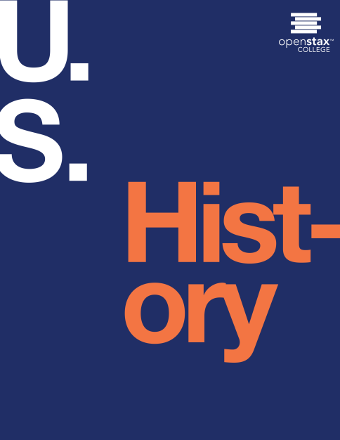
U.S. History
Chapter 29 Contesting Futures: America in the 1960s
PowerPoint Image Slideshow

Slide 2
Figure 29.1
In Aaron Shikler’s official portrait of John Fitzgerald Kennedy (1970), the president stands with arms folded, apparently deep in thought. The portrait was painted seven years after Kennedy’s death, at the request of his widow, Jacqueline Kennedy Onassis. It depicts the president with his head down, because Shikler did not wish to paint the dead man’s eyes.

Slide 3
Figure 29.2

Slide 4
Figure 29.3
John F. Kennedy and first lady Jacqueline, shown here in the White House in 1962 (a) and watching the America’s Cup race that same year (b), brought youth, glamour, and optimism to Washington, DC, and the nation.

Slide 5
Figure 29.4
On May 5, 1961, Alan Shepard became the first American to travel into space, as millions across the country watched the television coverage of his Apollo 11 mission, including Vice President Johnson, President Kennedy, and Jacqueline Kennedy in the White House. (credit: National Archives and Records Administration)

Slide 6
Figure 29.5
This low-level U.S. Navy photograph of San Cristobal, Cuba, clearly shows one of the sites built to launch intermediate-range missiles at the United States (a). As the date indicates, it was taken on the last day of the Cuban Missile Crisis. Following the crisis, Kennedy met with the reconnaissance pilots who flew the Cuban missions (b). credit a: modification of work by National Archives and Records Administration; credit b: modification of work by Central Intelligence Agency)

Slide 7
Figure 29.6
Following the French retreat from Indochina, the United States stepped in to prevent what it believed was a building Communist threat in the region. Under President Kennedy’s leadership, the United States sent thousands of military advisors to Vietnam. (credit: Abbie Rowe)

Slide 8
Figure 29.7
Escorted by a U.S. marshal and the assistant attorney general for civil rights, James Meredith (center) enters the University of Mississippi over the riotous protests of white southerners. Meredith later attempted a “March against Fear” in 1966 to protest the inability of southern African Americans to vote. His walk ended when a passing motorist shot and wounded him. (credit: Library of Congress)

Slide 9
Figure 29.8
Lee Harvey Oswald (center) was arrested at the Texas Theatre in Dallas a few hours after shooting President Kennedy.

Slide 10
Figure 29.9
In a speech at the University of Michigan in Ann Arbor on May 22, 1964 (a), President Johnson announced some of his goals for the Great Society. These included rebuilding cities, preserving the natural environment, and improving education. Johnson signed the Elementary and Secondary Education Act in his hometown of Johnson City, Texas, alongside his childhood schoolteacher, Kate Deadrich Loney (b). (credit a: modification of work by Cecil Stoughton)

Slide 11
Figure 29.10
President Johnson visits a poor family in Appalachia in 1964. Government initiatives designed to combat poverty helped rural communities like this one by providing low-interest loans and housing. (credit: Cecil Stoughton)

Slide 12
Figure 29.11
African American marchers in Selma, Alabama, were attacked by state police officers in 1965, and the resulting “Bloody Sunday” helped create support for the civil rights movement among northern whites. (credit: Library of Congress)

Slide 13
Figure 29.12
The Voting Rights Act (a) was signed into law on August 6, 1965, in the presence of major figures of the civil rights movement, including Rosa Parks and Martin Luther King, Jr. (b).

Slide 14
Figure 29.13
During the 1968 Tet Offensive, North Vietnamese and South Communist rebel armies known as Viet Cong attacked South Vietnamese and U.S. targets throughout Vietnam (a), with Saigon as the focus (b). Tet, the lunar New Year, was an important holiday in Vietnam and temporary ceasefires usually took place at this time. (credit a: modification of work by Central Intelligence Agency)

Slide 15
Figure 29.14
Businesses such as this one were among those that became targets of activists protesting segregation. Segregated businesses could be found throughout the United States; this one was located in Ohio. (credit: Library of Congress)

Slide 16
Figure 29.15
Civil rights activists Bayard Rustin, Andrew Young, Rep. William Fitts Ryan, James Farmer, and John Lewis (l to r) in a newspaper photograph from 1965.

Slide 17
Figure 29.16
During the March on Washington for Jobs and Freedom (a), a huge crowd gathered on the National Mall (b) to hear the speakers. Although thousands attended, many of the march’s organizers had hoped that enough people would come to Washington to shut down the city.

Slide 18
Figure 29.17
Many businesses, such as those in this neighborhood at the intersection of 7th and N Streets in NW, Washington, DC, were destroyed in riots that followed the assassination of Martin Luther King, Jr.

Slide 19
Figure 29.18
Stokely Carmichael (a), one of the most famous and outspoken advocates of Black Power, is surrounded by members of the media after speaking at Michigan State University in 1967. Malcolm X (b) was raised in a family influenced by Marcus Garvey and persecuted for its outspoken support of civil rights. While serving a stint in prison for armed robbery, he was introduced to and committed himself to the Nation of Islam. (credit b: modification of work by Library of Congress)

Slide 20
Figure 29.19
When the Jackson Five appeared on Soul Train, each of the five brothers sported a large afro, a symbol of Black Pride in the 1960s and 70s.

Slide 21
Figure 29.20
Cesar Chavez was influenced by the nonviolent philosophy of Indian nationalist Mahatma Gandhi. In 1968, he emulated Gandhi by engaging in a hunger strike.

Slide 22
Figure 29.21
Students at the University of Wisconsin-Madison protested the war in Vietnam in 1965. Their actions were typical of many on college campuses across the country during the 1960s. (credit: “Yarnalgo”/Flickr)

Slide 23
Figure 29.22
Early members of NOW discuss the problems faced by American women. Betty Friedan is second from the left. (credit: Smithsonian Institution Archives)

