Slide 1
U.S. HISTORY
Appendix D U.S. Political Map
PowerPoint Image Slideshow

Slide 2
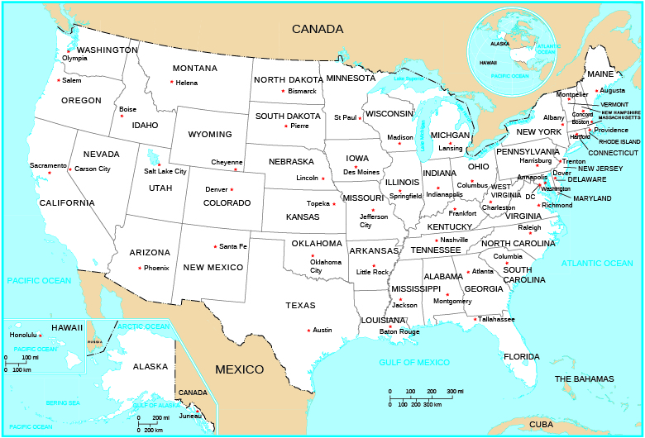
Figure D1
(credit: U.S. Department of the Interior, U.S. Geological Survey, The National Atlas of the United States of America/nationalatlas.gov)

