Slide 1
AMERICAN GOVERNMENT
Chapter 2 THE CONSTITUTION AND ITS ORIGINS
PowerPoint Image Slideshow

Slide 2
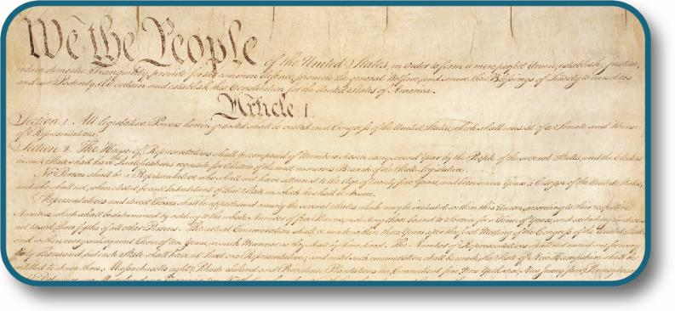
Figure 2.1
Written in 1787 and amended twenty-seven times, the U.S. Constitution is a living document that has served as the basis for U.S. government for more than two hundred years. (credit: modification of work by National Archives and Records Administration)

Slide 3
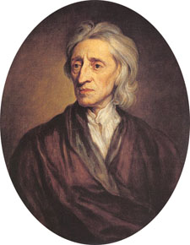
Figure 2.2
John Locke was one of the most influential thinkers of the Enlightenment. His writings form the basis for many modern political ideas.

Slide 4
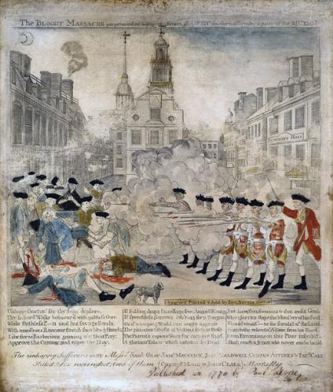
Figure 2.3
The Sons of Liberty circulated this sensationalized version of the events of March 5, 1770, in order to promote the rightness of their cause; it depicts British soldiers firing on unarmed civilians in the event that became known as the Boston Massacre. Later portrayals would more prominently feature Crispus Attucks, an African American who was one of the first to die. Eight British soldiers were tried for murder as a result of the confrontation.

Slide 5
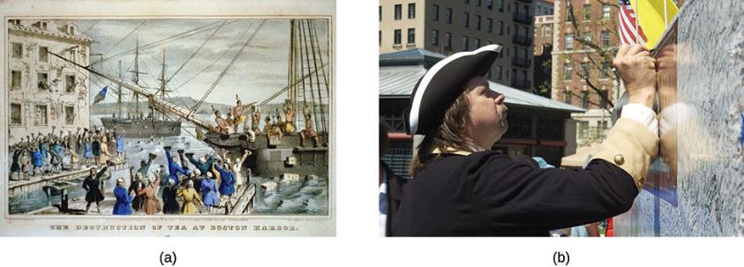
Figure 2.4
Members of the modern Tea Party movement claim to represent the same spirit as their colonial forebears in the iconic lithograph The Destruction of Tea at Boston Harbor (a) and protest against what they perceive as government’s interference with people’s rights. In April 2010, members of a Tea Party Express rally on the Boston Common signed a signature wall to record their protest (b). (credit b: modification of work by Tim Pierce)

Slide 6
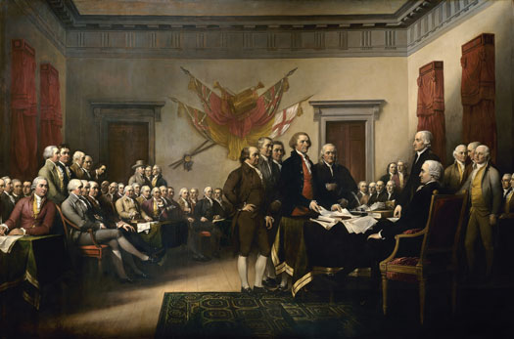
Figure 2.5
The presentation of the Declaration of Independence is commemorated in a painting by John Trumbull in 1817. It was commissioned to hang in the Capitol in Washington, DC.

Slide 7
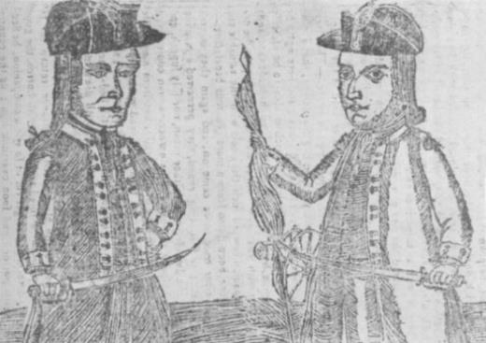
Figure 2.6
This contemporary depiction of Continental Army veteran Daniel Shays (left) and Job Shattuck (right), who led an uprising of Massachusetts farmers in 1786–1787 that prompted calls for a stronger national government, appeared on the cover of Bickerstaff’s Genuine Boston Almanack for 1787.

Slide 8
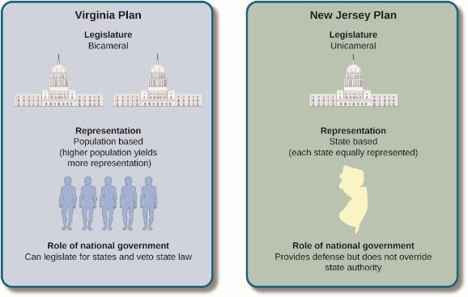
Figure 2.7
The Virginia Plan called for a two-house legislature. Representation in both houses would be based on population. A state’s representatives in one house would be elected by the state’s voters. These representatives would then appoint representatives to the second house from among candidates chosen by the state’s legislature. The New Jersey Plan favored maintaining a one-house Congress with each state being equally represented.

Slide 9
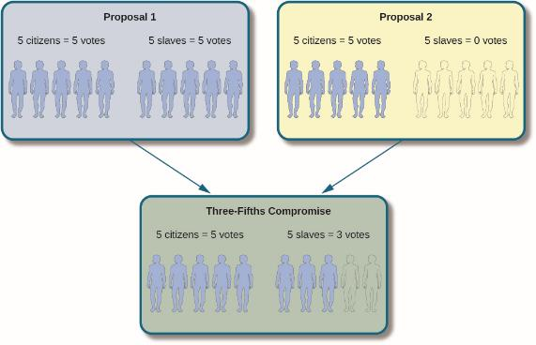
Figure 2.8
This infographic shows the methods proposed for counting slave populations and the resulting Three-Fifths Compromise.

Slide 10
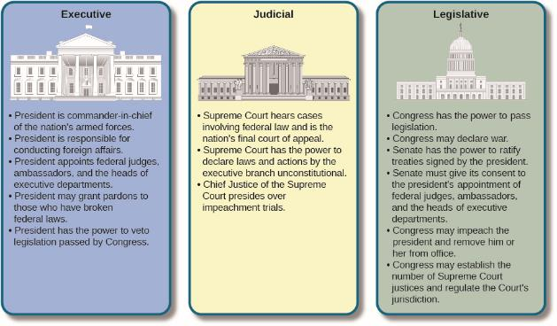
Figure 2.9
To prevent the national government, or any one group within it, from becoming too powerful, the Constitution divided the government into three branches with different powers. No branch could function without the cooperation of the others, and each branch could restrict the powers of the others.

Slide 11
Figure 2.10
Reserve powers allow the states to pass intrastate legislation, such as laws on commerce, drug use, and marriage (a). However, sometimes judicial rulings at the federal level may supersede such legislation, as happened in Obergefell v. Hodges (2015), the recent Supreme Court case regarding marriage equality (b). (credit a: modification of work by Damian Gadal; credit b: modification of work by Ludovic Bertron)

Slide 12
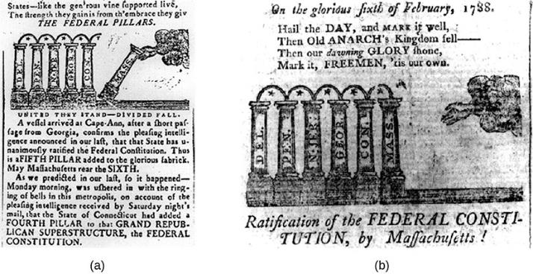
Figure 2.11
This Massachusetts Sentinel cartoon (a) encourages the state’s voters to join Georgia and neighboring Connecticut in ratifying the Constitution. Less than a month later, on February 6, 1788, Massachusetts became the sixth member of the newly formed federal union (b).

Slide 13
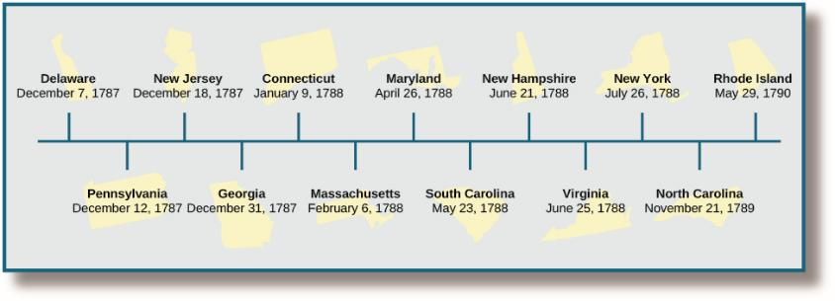
Figure 2.12
This timeline shows the order in which states ratified the new Constitution. Small states that would benefit from the protection of a larger union ratified the Constitution fairly quickly, such as Delaware and Connecticut. Larger, more populous states like Virginia and New York took longer. The last state to ratify was Rhode Island, a state that had always proven reluctant to act alongside the others.

Slide 14
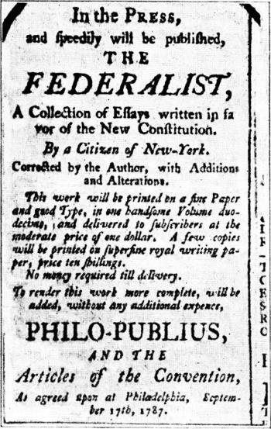
Figure 2.13
From 1787 to 1788, Alexander Hamilton, James Madison, and John Jay authored a series of essays intended to convince Americans, especially New Yorkers, to support the new Constitution. These essays, which originally appeared in newspapers, were collected and published together under the title The Federalist in 1788. They are now known as The Federalist Papers.

Slide 15
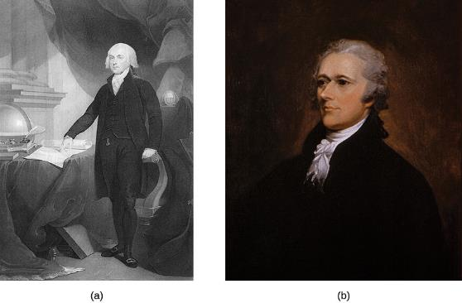
Figure 2.14
James Madison (a) played a vital role in the formation of the Constitution. He was an important participant in the Constitutional Convention and authored many of The Federalist Papers. Despite the fact that he did not believe that a Bill of Rights was necessary, he wrote one in order to allay the fears of those who believed the federal government was too powerful. He also served as Thomas Jefferson’s vice president and was elected president himself in 1808. Alexander Hamilton (b) was one of the greatest political minds of the early United States. He authored the majority of The Federalist Papers and served as Secretary of the Treasury in George Washington’s administration.

Slide 16
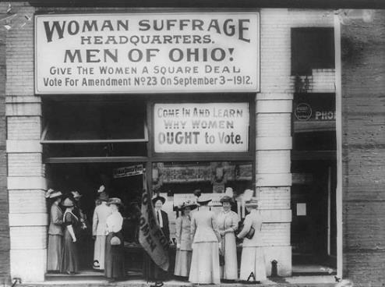
Figure 2.15
Suffragists encourage Ohio men to support votes for women. Before the Nineteenth Amendment was added to the Constitution in 1920, only a few western states such as Wyoming gave women the right to vote. These women seem to be attracting a primarily female audience to hear their cause.

