Slide 1
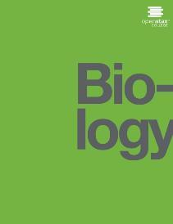
Biology
Chapter 17 BIOTECHNOLOGY AND GENOMICS
PowerPoint Image Slideshow

Slide 2
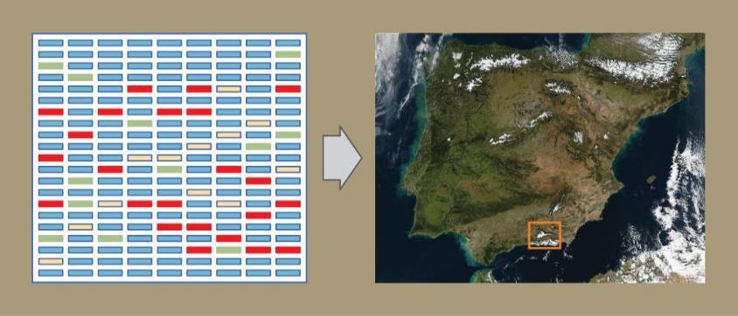
Figure 17.1
In genomics, the DNA of different organisms is compared, enabling scientists to create maps with which to navigate the DNA of different organisms. (credit “map”: modification of photo by NASA)

Slide 3
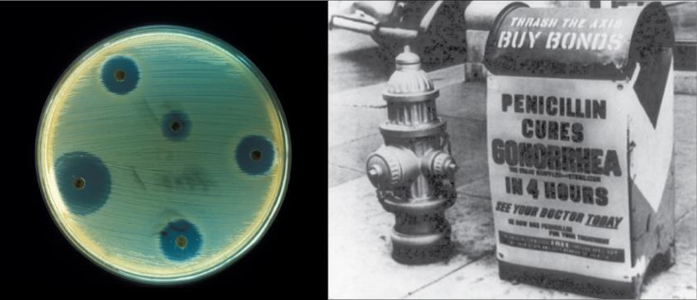
Figure 17.2
Antibiotics are chemicals produced by fungi, bacteria, and other organisms that have antimicrobial properties. The first antibiotic discovered was penicillin. Antibiotics are now commercially produced and tested for their potential to inhibit bacterial growth. (credit “advertisement”: modification of work by NIH; credit “test plate”: modification of work by Don Stalons/ CDC; scale-bar data from Matt Russell)

Slide 4
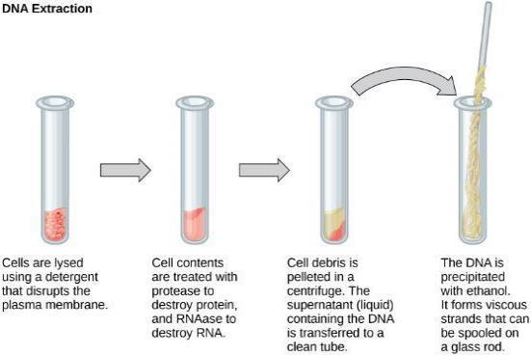
Figure 17.3
This diagram shows the basic method used for extraction of DNA.

Slide 5
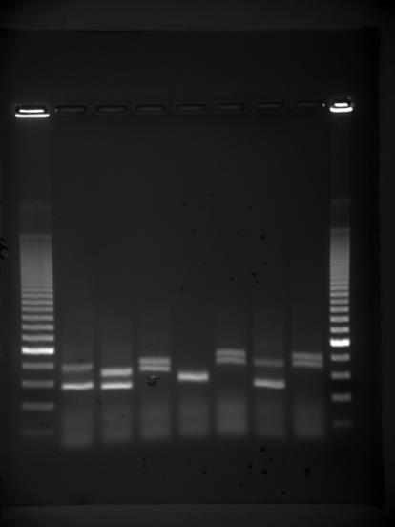
Figure 17.4
Shown are DNA fragments from seven samples run on a gel, stained with a fluorescent dye, and viewed under UV light. (credit: James Jacob, Tompkins Cortland Community College)

Slide 6
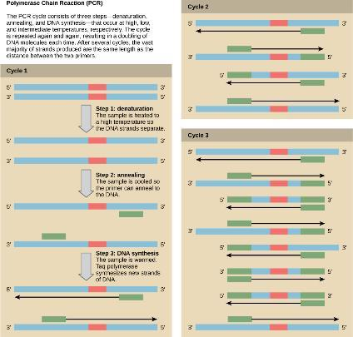
Figure 17.5
Polymerase chain reaction, or PCR, is used to amplify a specific sequence of DNA. Primers—short pieces of DNA complementary to each end of the target sequence—are combined with genomic DNA, Taq polymerase, and deoxynucleotides. Taq polymerase is a DNA polymerase isolated from the thermostable bacterium Thermus aquaticus that is able to withstand the high temperatures used in PCR. Thermus aquaticus grows in the Lower Geyser Basin of Yellowstone National Park. Reverse transcriptase PCR (RT-PCR) is similar to PCR, but cDNA is made from an RNA template before PCR begins.

Slide 7
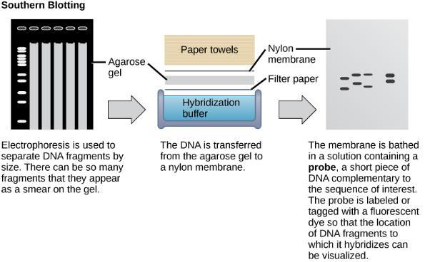
Figure 17.6
Southern blotting is used to find a particular sequence in a sample of DNA. DNA fragments are separated on a gel, transferred to a nylon membrane, and incubated with a DNA probe complementary to the sequence of interest. Northern blotting is similar to Southern blotting, but RNA is run on the gel instead of DNA. In western blotting, proteins are run on a gel and detected using antibodies.

Slide 8
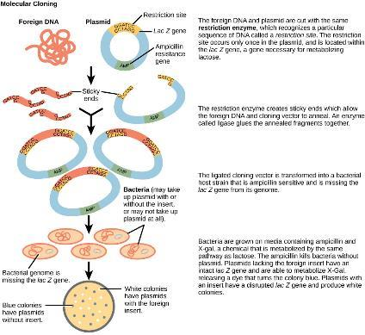
Figure 17.7
This diagram shows the steps involved in molecular cloning.

Slide 9
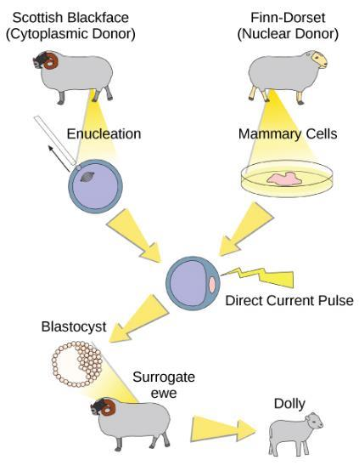
Figure 17.8
Dolly the sheep was the first mammal to be cloned. To create Dolly, the nucleus was removed from a donor egg cell. The nucleus from a second sheep was then introduced into the cell, which was allowed to divide to the blastocyst stage before being implanted in a surrogate mother. (credit: modification of work by “Squidonius”/Wikimedia Commons)

Slide 10
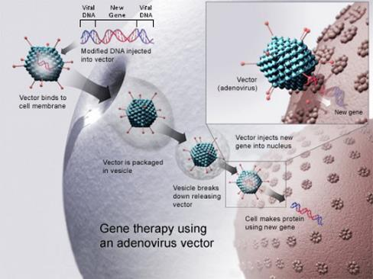
Figure 17.9
Gene therapy using an adenovirus vector can be used to cure certain genetic diseases in which a person has a defective gene. (credit: NIH)

Slide 11
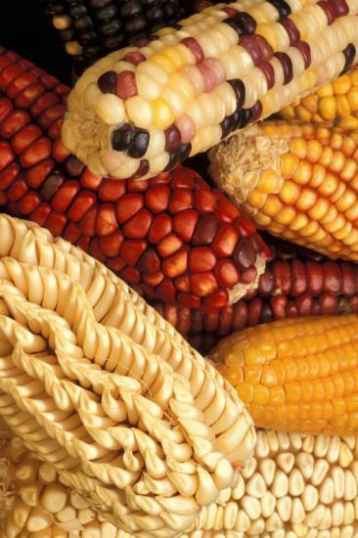
Figure 17.10
Corn, a major agricultural crop used to create products for a variety of industries, is often modified through plant biotechnology. (credit: Keith Weller, USDA)

Slide 12
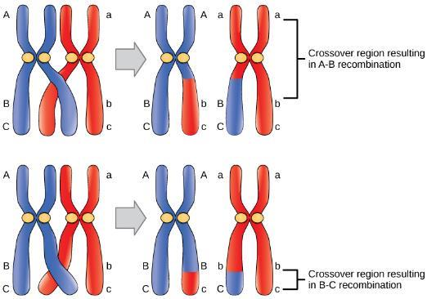
Figure 17.11
Crossover may occur at different locations on the chromosome. Recombination between genes A and B is more frequent than recombination between genes B and C because genes A and B are farther apart; a crossover is therefore more likely to occur between them.

Slide 13
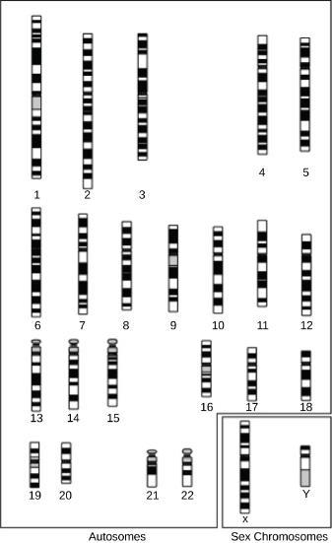
Figure 17.12
A cytogenetic map shows the appearance of a chromosome after it is stained and examined under a microscope. (credit: National Human Genome Research Institute)

Slide 14
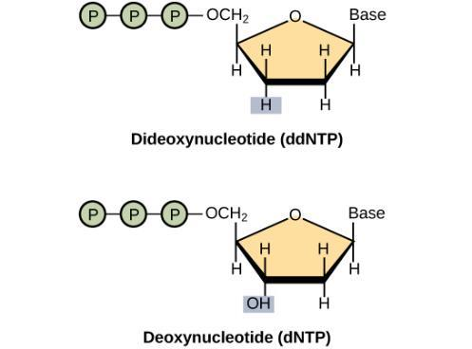
Figure 17.13
A dideoxynucleotide is similar in structure to a deoxynucleotide, but is missing the 3’ hydroxyl group (indicated by the box). When a dideoxynucleotide is incorporated into a DNA strand, DNA synthesis stops.

Slide 15
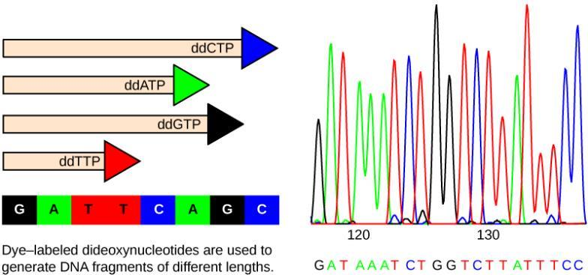
Figure 17.14
Frederick Sanger's dideoxy chain termination method is illustrated. Using dideoxynucleotides, the DNA fragment can be terminated at different points. The DNA is separated on the basis of size, and these bands, based on the size of the fragments, can be read.

Slide 16
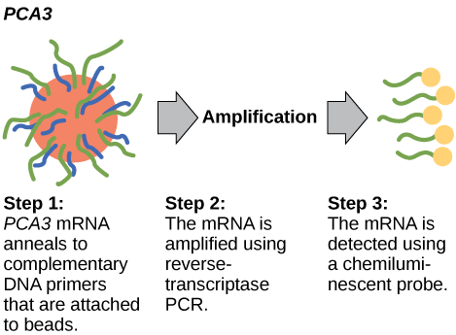
Figure 17.15
PCA3 is a gene that is expressed in prostate epithelial cells and overexpressed in cancerous cells. A high concentration of PCA3 in urine is indicative of prostate cancer. The PCA3 test is considered to be a better indicator of cancer than the more well know PSA test, which measures the level of PSA (prostate-specific antigen) in the blood.

Slide 17
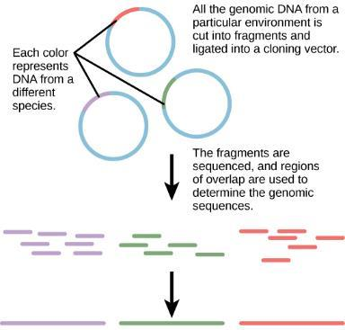
Figure 17.16
Metagenomics involves isolating DNA from multiple species within an environmental niche.

Slide 18
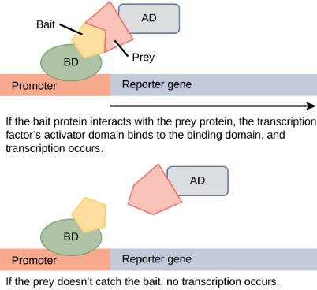
Figure 17.17
Two-hybrid screening is used to determine whether two proteins interact. In this method, a transcription factor is split into a DNA-binding domain (BD) and an activator domain (AD). The binding domain is able to bind the promoter in the absence of the activator domain, but it does not turn on transcription. A protein called the bait is attached to the BD, and a protein called the prey is attached to the AD. Transcription occurs only if the prey “catches” the bait.

