Slide 1
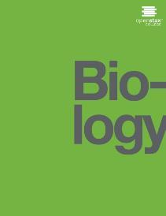
Biology
Chapter 12 MENDEL’S EXPERIMENTS AND HEREDITY
PowerPoint Image Slideshow

Slide 2
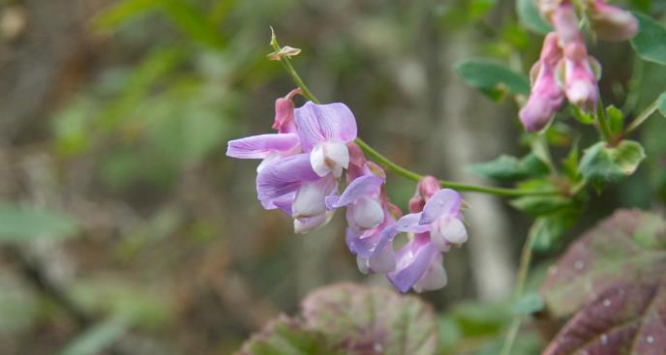
Figure 12.1
Experimenting with thousands of garden peas, Mendel uncovered the fundamentals of genetics. (credit: modification of work by Jerry Kirkhart)

Slide 3
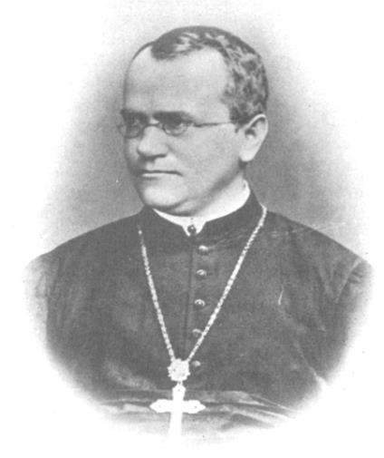
Figure 12.2
Johann Gregor Mendel is considered the father of genetics.

Slide 4
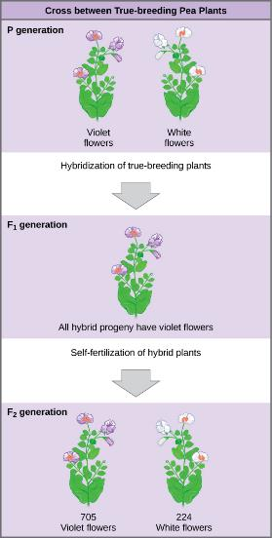
Figure 12.3
In one of his experiments on inheritance patterns, Mendel crossed plants that were true-breeding for violet flower color with plants true-breeding for white flower color (the P generation). The resulting hybrids in the F₁ generation all had violet flowers. In the F₂ generation, approximately three quarters of the plants had violet flowers, and one quarter had white flowers.

Slide 5
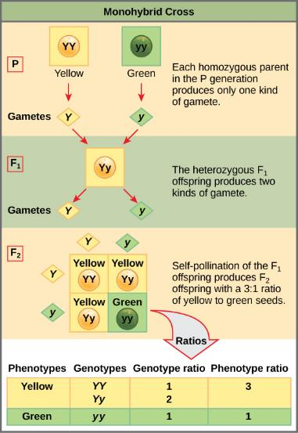
Figure 12.4
In the P generation, pea plants that are true-breeding for the dominant yellow phenotype are crossed with plants with the recessive green phenotype. This cross produces F₁ heterozygotes with a yellow phenotype. Punnett square analysis can be used to predict the genotypes of the F₂ generation.

Slide 6
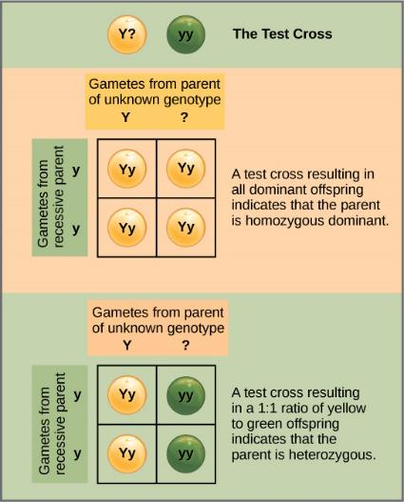
Figure 12.5
A test cross can be performed to determine whether an organism expressing a dominant trait is a homozygote or a heterozygote.

Slide 7
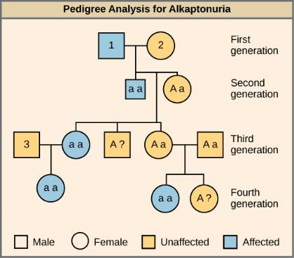
Figure 12.6
Alkaptonuria is a recessive genetic disorder in which two amino acids, phenylalanine and tyrosine, are not properly metabolized. Affected individuals may have darkened skin and brown urine, and may suffer joint damage and other complications. In this pedigree, individuals with the disorder are indicated in blue and have the genotype aa. Unaffected individuals are indicated in yellow and have the genotype AA or Aa. Note that it is often possible to determine a person’s genotype from the genotype of their offspring. For example, if neither parent has the disorder but their child does, they must be heterozygous. Two individuals on the pedigree have an unaffected phenotype but unknown genotype. Because they do not have the disorder, they must have at least one normal allele, so their genotype gets the “A?” designation.

Slide 8
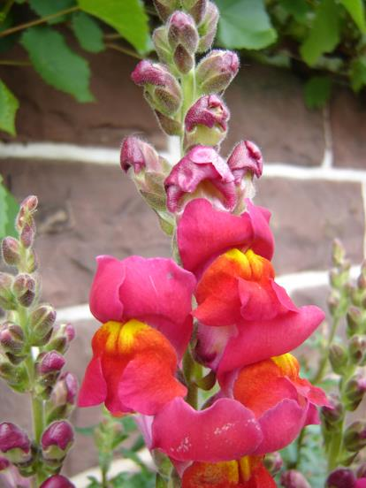
Figure 12.7
These pink flowers of a heterozygote snapdragon result from incomplete dominance. (credit: “storebukkebruse”/Flickr)

Slide 9
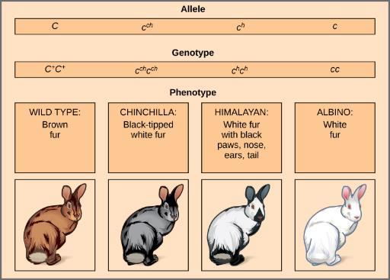
Figure 12.8
Four different alleles exist for the rabbit coat color (C) gene.

Slide 10
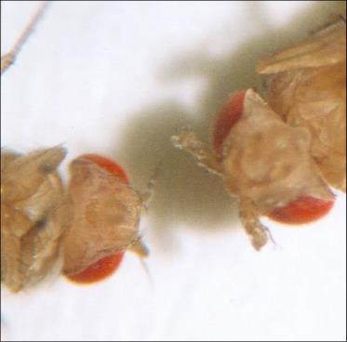
Figure 12.9
As seen in comparing the wild-type Drosophila (left) and the Antennapedia mutant (right), the Antennapedia mutant has legs on its head in place of antennae.

Slide 11
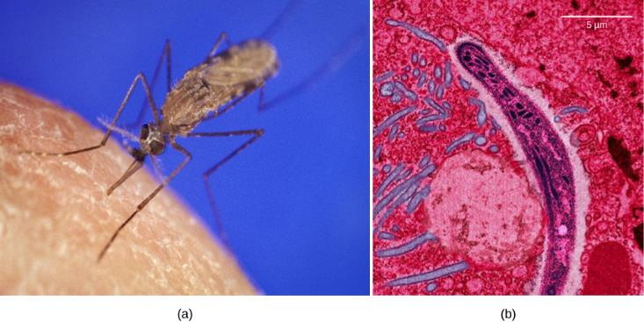
Figure 12.10
The (a) Anopheles gambiae, or African malaria mosquito, acts as a vector in the transmission to humans of the malaria-causing parasite (b) Plasmodium falciparum, here visualized using false-color transmission electron microscopy. (credit a: James D. Gathany; credit b: Ute Frevert; false color by Margaret Shear; scale-bar data from Matt Russell)

Slide 12
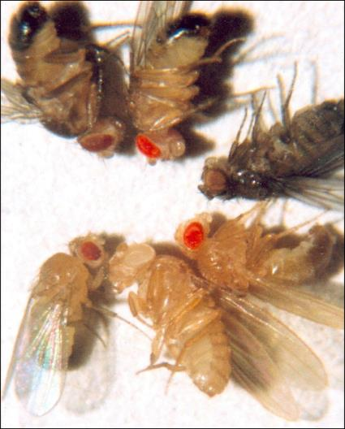
Figure 12.11
In Drosophila, the gene for eye color is located on the X chromosome. Clockwise from top left are brown, cinnabar, sepia, vermilion, white, and red. Red eye color is wild-type and is dominant to white eye color.

Slide 13
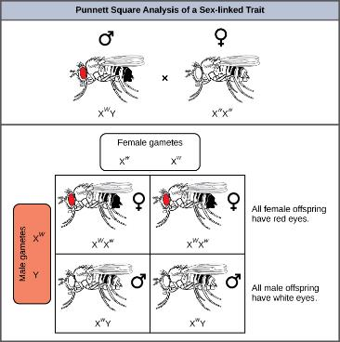
Figure 12.12
Punnett square analysis is used to determine the ratio of offspring from a cross between a red-eyed male fruit fly and a white-eyed female fruit fly.

Slide 14
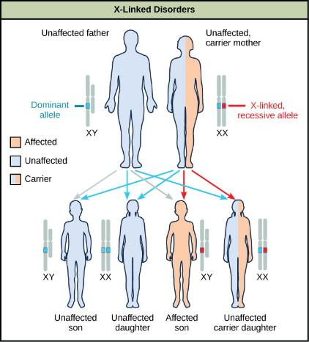
Figure 12.13
The son of a woman who is a carrier of a recessive X-linked disorder will have a 50 percent chance of being affected. A daughter will not be affected, but she will have a 50 percent chance of being a carrier like her mother.

Slide 15
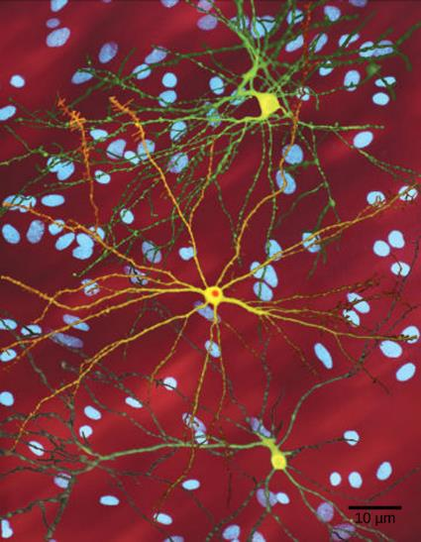
Figure 12.14
The neuron in the center of this micrograph (yellow) has nuclear inclusions characteristic of Huntington’s disease (orange area in the center of the neuron). Huntington’s disease occurs when an abnormal dominant allele for the Huntington gene is present. (credit: Dr. Steven Finkbeiner, Gladstone Institute of Neurological Disease, The Taube-Koret Center for Huntington's Disease Research, and the University of California San Francisco/Wikimedia)

Slide 16
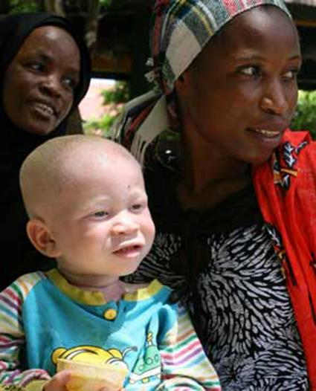
Figure 12.15
The child in the photo expresses albinism, a recessive trait.

Slide 17
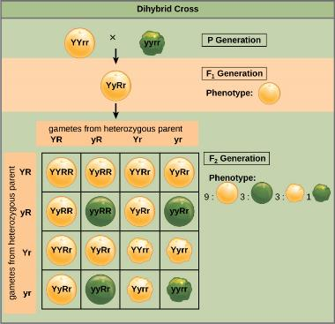
Figure 12.16
This dihybrid cross of pea plants involves the genes for seed color and texture.

Slide 18
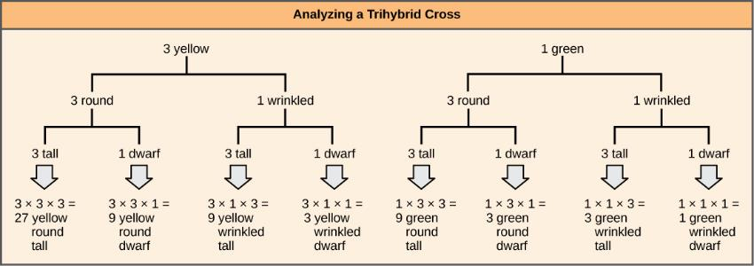
Figure 12.17
The forked-line method can be used to analyze a trihybrid cross. Here, the probability for color in the F₂ generation occupies the top row (3 yellow:1 green). The probability for shape occupies the second row (3 round:1 wrinkled), and the probability for height occupies the third row (3 tall:1 dwarf). The probability for each possible combination of traits is calculated by multiplying the probability for each individual trait. Thus, the probability of F₂ offspring having yellow, round, and tall traits is 3 x 3 x 3, or 27.

Slide 19
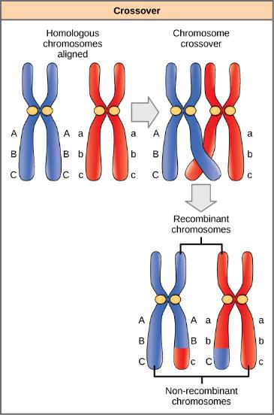
Figure 12.18
The process of crossover, or recombination, occurs when two homologous chromosomes align during meiosis and exchange a segment of genetic material. Here, the alleles for gene C were exchanged. The result is two recombinant and two non-recombinant chromosomes.

Slide 20
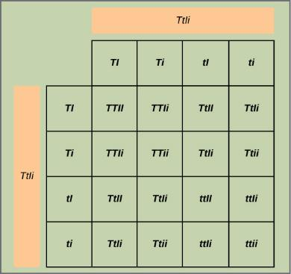
Figure 12.19
This figure shows all possible combinations of offspring resulting from a dihybrid cross of pea plants that are heterozygous for the tall/dwarf and inflated/constricted alleles.

Slide 21
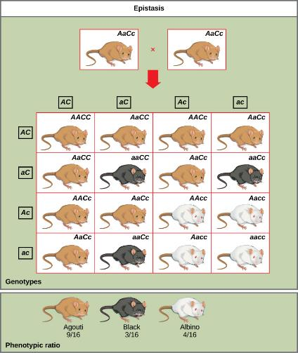
Figure 12.20
In mice, the mottled agouti coat color (A) is dominant to a solid coloration, such as black or gray. A gene at a separate locus (C) is responsible for pigment production. The recessive c allele does not produce pigment, and a mouse with the homozygous recessive cc genotype is albino regardless of the allele present at the A locus. Thus, the C gene is epistatic to the A gene.

