Slide 1
Biology
Chapter 16 GENE EXPRESSION
PowerPoint Image Slideshow

Slide 2
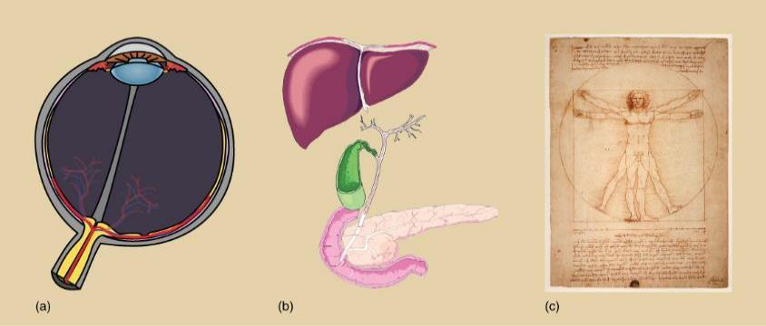
Figure 16.1
The genetic content of each somatic cell in an organism is the same, but not all genes are expressed in every cell. The control of which genes are expressed dictates whether a cell is (a) an eye cell or (b) a liver cell. It is the differential gene expression patterns that arise in different cells that give rise to (c) a complete organism.

Slide 3
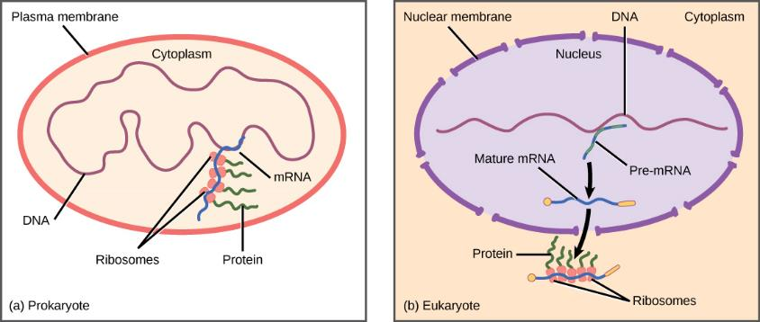
Figure 16.2
Prokaryotic transcription and translation occur simultaneously in the cytoplasm, and regulation occurs at the transcriptional level. Eukaryotic gene expression is regulated during transcription and RNA processing, which take place in the nucleus, and during protein translation, which takes place in the cytoplasm. Further regulation may occur through post-translational modifications of proteins.

Slide 4
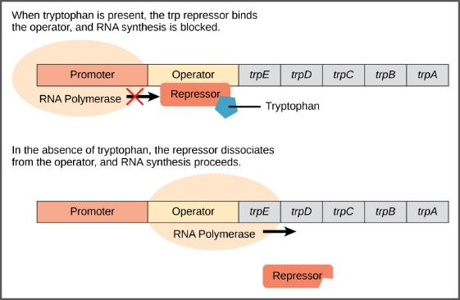
Figure 16.3
The five genes that are needed to synthesize tryptophan in E. coli are located next to each other in the trp operon. When tryptophan is plentiful, two tryptophan molecules bind the repressor protein at the operator sequence. This physically blocks the RNA polymerase from transcribing the tryptophan genes. When tryptophan is absent, the repressor protein does not bind to the operator and the genes are transcribed.

Slide 5
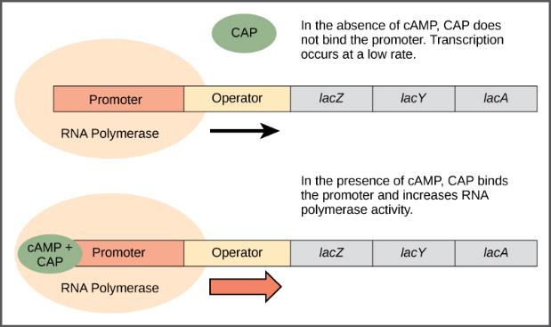
Figure 16.4
When glucose levels fall, E. coli may use other sugars for fuel but must transcribe new genes to do so. As glucose supplies become limited, cAMP levels increase. This cAMP binds to the CAP protein, a positive regulator that binds to an operator region upstream of the genes required to use other sugar sources.

Slide 6
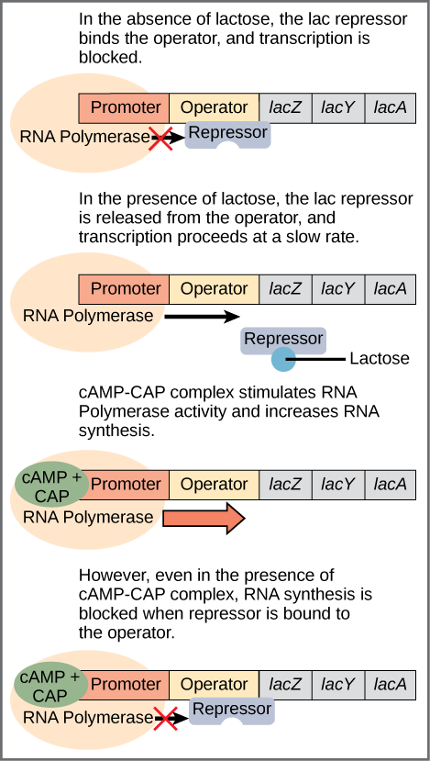
Figure 16.5
Transcription of the lac operon is carefully regulated so that its expression only occurs when glucose is limited and lactose is present to serve as an alternative fuel source.

Slide 7
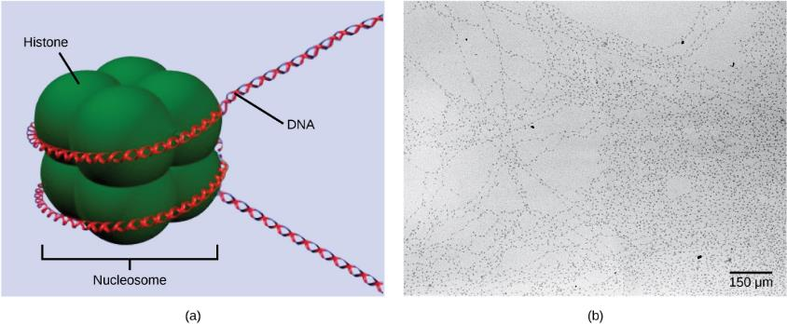
Figure 16.6
DNA is folded around histone proteins to create (a) nucleosome complexes. These nucleosomes control the access of proteins to the underlying DNA. When viewed through an electron microscope (b), the nucleosomes look like beads on a string. (credit “micrograph”: modification of work by Chris Woodcock)

Slide 8
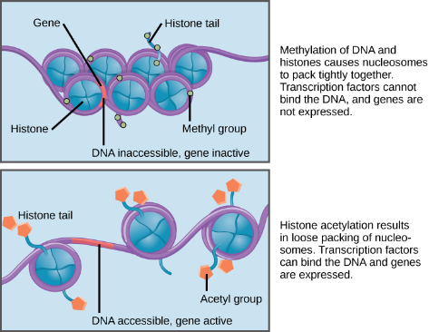
Figure 16.7
Nucleosomes can slide along DNA. When nucleosomes are spaced closely together (top), transcription factors cannot bind and gene expression is turned off. When the nucleosomes are spaced far apart (bottom), the DNA is exposed. Transcription factors can bind, allowing gene expression to occur. Modifications to the histones and DNA affect nucleosome spacing.

Slide 9
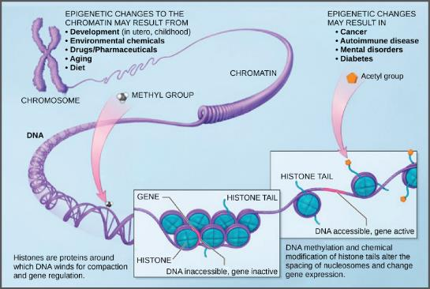
Figure 16.8
Histone proteins and DNA nucleotides can be modified chemically. Modifications affect nucleosome spacing and gene expression. (credit: modification of work by NIH)

Slide 10
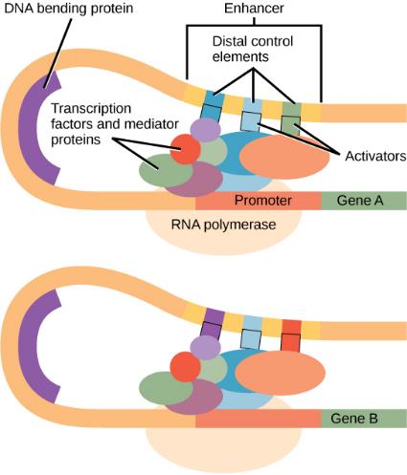
Figure 16.9
An enhancer is a DNA sequence that promotes transcription. Each enhancer is made up of short DNA sequences called distal control elements. Activators bound to the distal control elements interact with mediator proteins and transcription factors. Two different genes may have the same promoter but different distal control elements, enabling differential gene expression.

Slide 11
Figure 16.10
Pre-mRNA can be alternatively spliced to create different proteins.

Slide 12
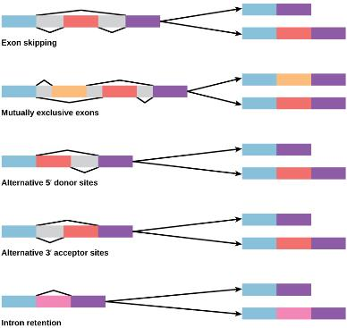
Figure 16.11
There are five basic modes of alternative splicing.

Slide 13
Figure 16.12
The protein-coding region of mRNA is flanked by 5' and 3' untranslated regions (UTRs). The presence of RNA-binding proteins at the 5' or 3' UTR influences the stability of the RNA molecule.

Slide 14
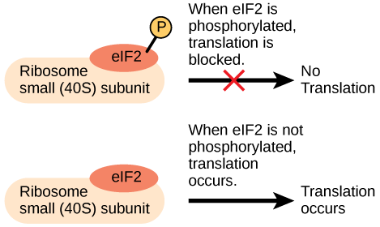
Figure 16.13
Gene expression can be controlled by factors that bind the translation initiation complex.

Slide 15
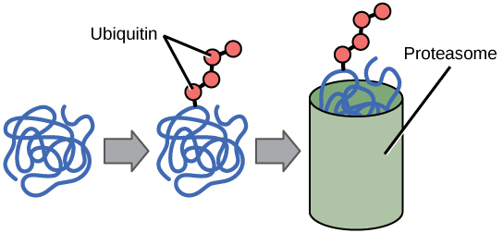
Figure 16.14
Proteins with ubiquitin tags are marked for degradation within the proteasome.

