Slide 1
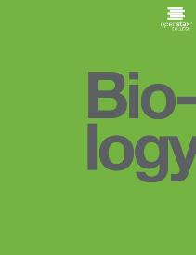
BIOLOGY
Chapter 10 CELL REPRODUCTION
PowerPoint Image Slideshow

Slide 2
Figure 10.1
A sea urchin begins life as a single cell that (a) divides to form two cells, visible by scanning electron microscopy. After four rounds of cell division, (b) there are 16 cells, as seen in this SEM image. After many rounds of cell division, the individual develops into a complex, multicellular organism, as seen in this (c) mature sea urchin. (credit a: modification of work by Evelyn Spiegel, Louisa Howard; credit b: modification of work by Evelyn Spiegel, Louisa Howard; credit c: modification of work by Marco Busdraghi; scale-bar data from Matt Russell)

Slide 3
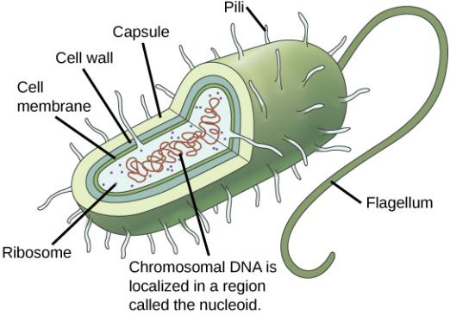
Figure 10.2
Prokaryotes, including bacteria and archaea, have a single, circular chromosome located in a central region called the nucleoid.

Slide 4
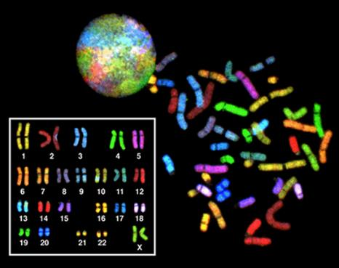
Figure 10.3
There are 23 pairs of homologous chromosomes in a female human somatic cell. The chromosomes are viewed within the nucleus (top), removed from a cell in mitosis and spread out on a slide (right), and artificially arranged according to length (left); an arrangement like this is called a karyotype. In this image, the chromosomes were exposed to fluorescent stains for differentiation of the different chromosomes. A method of staining called “chromosome painting” employs fluorescent dyes that highlight chromosomes in different colors. (credit: National Human Genome Project/NIH)

Slide 5
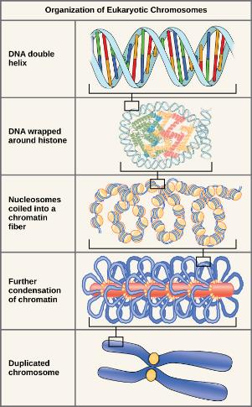
Figure 10.4
Double-stranded DNA wraps around histone proteins to form nucleosomes that have the appearance of “beads on a string.” The nucleosomes are coiled into a 30-nm chromatin fiber. When a cell undergoes mitosis, the chromosomes condense even further.

Slide 6
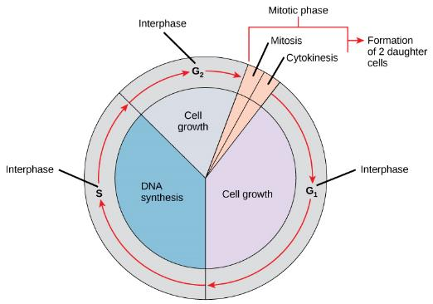
Figure 10.5
The cell cycle consists of interphase and the mitotic phase. During interphase, the cell grows and the nuclear DNA is duplicated. Interphase is followed by the mitotic phase. During the mitotic phase, the duplicated chromosomes are segregated and distributed into daughter nuclei. The cytoplasm is usually divided as well, resulting in two daughter cells.

Slide 7
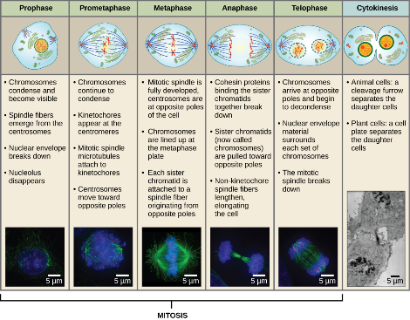
Figure 10.6
Karyokinesis (or mitosis) is divided into five stages—prophase, prometaphase, metaphase, anaphase, and telophase. The pictures at the bottom were taken by fluorescence microscopy (hence, the black background) of cells artificially stained by fluorescent dyes: blue fluorescence indicates DNA (chromosomes) and green fluorescence indicates microtubules (spindle apparatus). (credit “mitosis drawings”: modification of work by Mariana Ruiz Villareal; credit “micrographs”: modification of work by Roy van Heesbeen; credit “cytokinesis micrograph”: Wadsworth Center/New York State Department of Health; scale-bar data from Matt Russell)

Slide 8
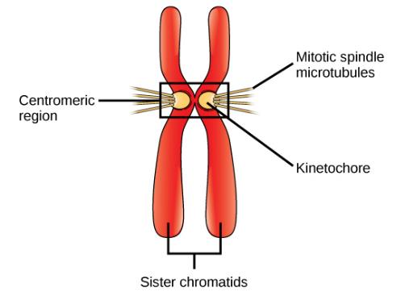
Figure 10.7
During prometaphase, mitotic spindle microtubules from opposite poles attach to each sister chromatid at the kinetochore. In anaphase, the connection between the sister chromatids breaks down, and the microtubules pull the chromosomes toward opposite poles.

Slide 9
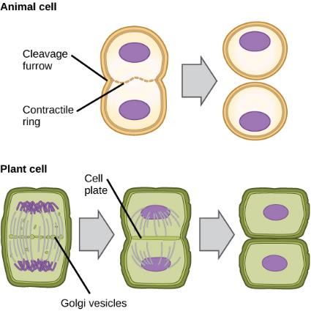
Figure 10.8
During cytokinesis in animal cells, a ring of actin filaments forms at the metaphase plate. The ring contracts, forming a cleavage furrow, which divides the cell in two. In plant cells, Golgi vesicles coalesce at the former metaphase plate, forming a phragmoplast. A cell plate formed by the fusion of the vesicles of the phragmoplast grows from the center toward the cell walls, and the membranes of the vesicles fuse to form a plasma membrane that divides the cell in two.

Slide 10
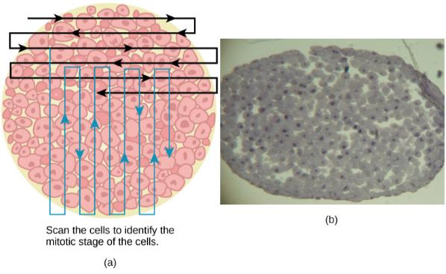
Figure 10.9
Slowly scan whitefish blastula cells with the high-power objective as illustrated in image (a) to identify their mitotic stage. (b) A microscopic image of the scanned cells is shown. (credit “micrograph”: modification of work by Linda Flora; scale-bar data from Matt Russell)

Slide 11
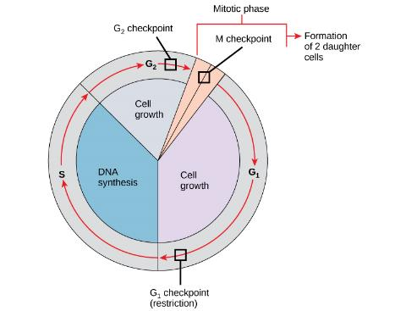
Figure 10.10
The cell cycle is controlled at three checkpoints. The integrity of the DNA is assessed at the G₁ checkpoint. Proper chromosome duplication is assessed at the G₂ checkpoint. Attachment of each kinetochore to a spindle fiber is assessed at the M checkpoint.

Slide 12
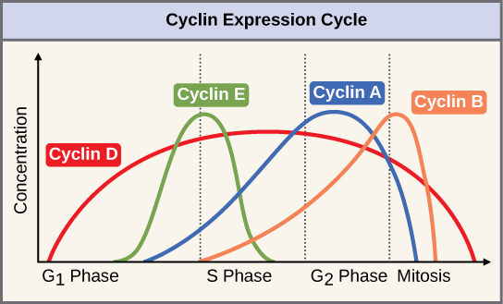
Figure 10.11
The concentrations of cyclin proteins change throughout the cell cycle. There is a direct correlation between cyclin accumulation and the three major cell cycle checkpoints. Also note the sharp decline of cyclin levels following each checkpoint (the transition between phases of the cell cycle), as cyclin is degraded by cytoplasmic enzymes. (credit: modification of work by “WikiMiMa”/Wikimedia Commons)

Slide 13
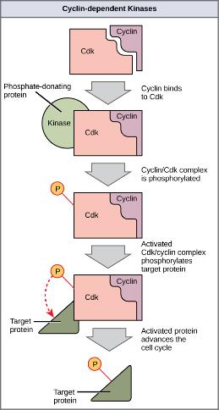
Figure 10.12
Cyclin-dependent kinases (Cdks) are protein kinases that, when fully activated, can phosphorylate and thus activate other proteins that advance the cell cycle past a checkpoint. To become fully activated, a Cdk must bind to a cyclin protein and then be phosphorylated by another kinase.

Slide 14
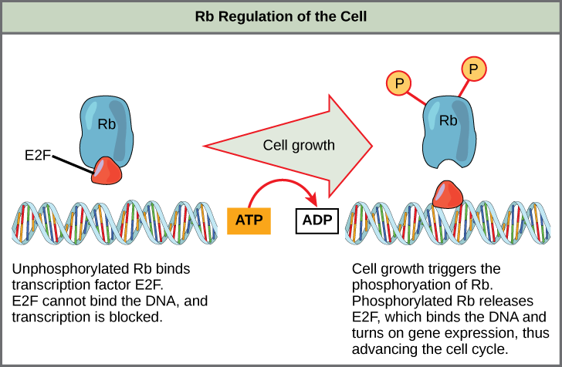
Figure 10.13
Rb halts the cell cycle and releases its hold in response to cell growth.

Slide 15
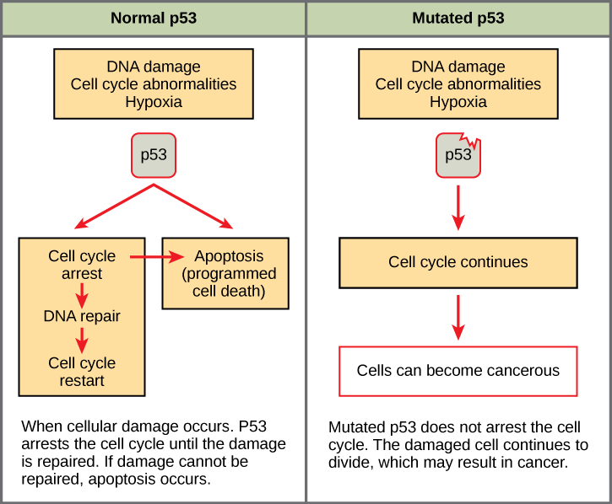
Figure 10.14
The role of normal p53 is to monitor DNA and the supply of oxygen (hypoxia is a condition of reduced oxygen supply). If damage is detected, p53 triggers repair mechanisms. If repairs are unsuccessful, p53 signals apoptosis. A cell with an abnormal p53 protein cannot repair damaged DNA and thus cannot signal apoptosis. Cells with abnormal p53 can become cancerous. (credit: modification of work by Thierry Soussi)

Slide 16
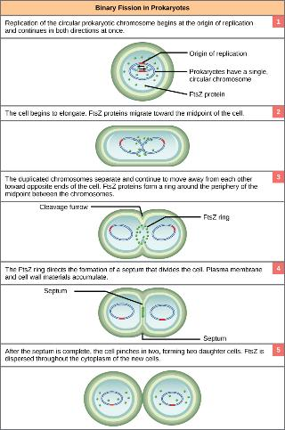
Figure 10.15
These images show the steps of binary fission in prokaryotes. (credit: modification of work by “Mcstrother”/Wikimedia Commons)

