Slide 1
Biology
Chapter 15 GENES AND PROTEINS
PowerPoint Image Slideshow

Slide 2
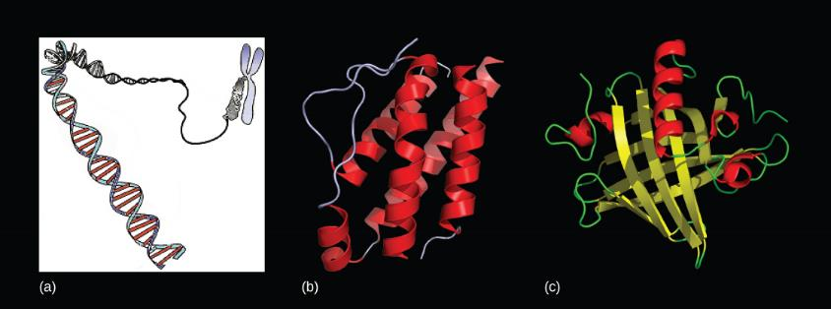
Figure 15.1
Genes, which are carried on (a) chromosomes, are linearly organized instructions for making the RNA and protein molecules that are necessary for all of processes of life. The (b) interleukin-2 protein and (c) alpha-2u-globulin protein are just two examples of the array of different molecular structures that are encoded by genes. (credit “chromosome: National Human Genome Research Institute; credit “interleukin-2”: Ramin Herati/Created from PDB 1M47 and rendered with Pymol; credit “alpha-2u-globulin”: Darren Logan/rendered with AISMIG)

Slide 3
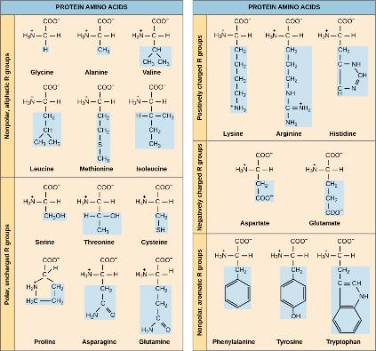
Figure 15.2
Structures of the 20 amino acids found in proteins are shown. Each amino acid is composed of an amino group ( NH₃⁺ ), a carboxyl group (COO⁻), and a side chain (blue). The side chain may be nonpolar, polar, or charged, as well as large or small. It is the variety of amino acid side chains that gives rise to the incredible variation of protein structure and function.

Slide 4
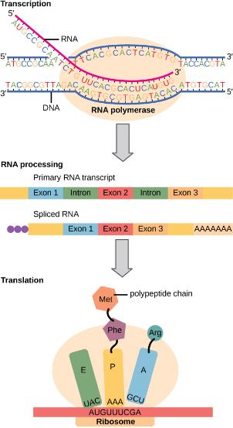
Figure 15.3
Instructions on DNA are transcribed onto messenger RNA. Ribosomes are able to read the genetic information inscribed on a strand of messenger RNA and use this information to string amino acids together into a protein.

Slide 5
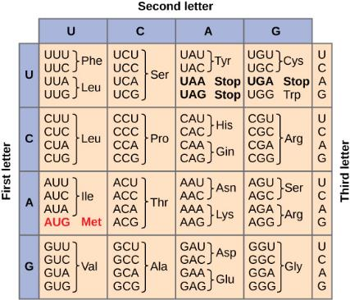
Figure 15.4
This figure shows the genetic code for translating each nucleotide triplet in mRNA into an amino acid or a termination signal in a nascent protein. (credit: modification of work by NIH)

Slide 6
Figure 15.5
The deletion of two nucleotides shifts the reading frame of an mRNA and changes the entire protein message, creating a nonfunctional protein or terminating protein synthesis altogether.

Slide 7
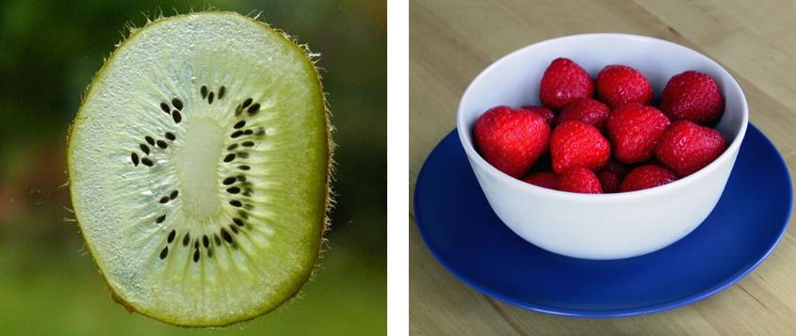
Figure 15.6
Do you think that a kiwi or a strawberry has more DNA per fruit? (credit “kiwi”: "Kelbv"/Flickr; credit: “strawberry”: Alisdair McDiarmid)

Slide 8
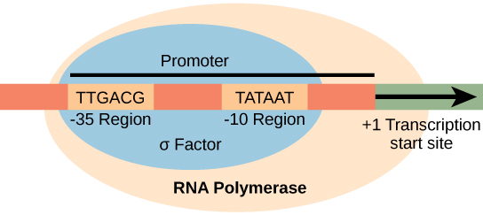
Figure 15.7
The σ subunit of prokaryotic RNA polymerase recognizes consensus sequences found in the promoter region upstream of the transcription start sight. The σ subunit dissociates from the polymerase after transcription has been initiated.

Slide 9
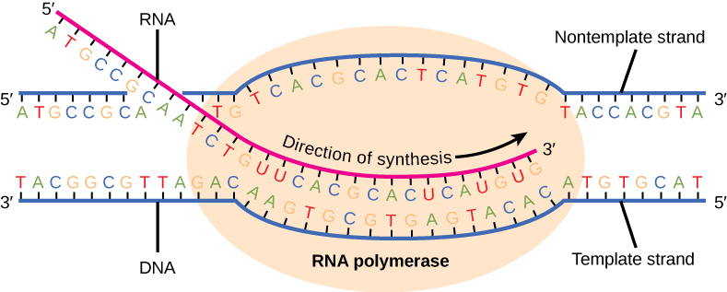
Figure 15.8
During elongation, the prokaryotic RNA polymerase tracks along the DNA template, synthesizes mRNA in the 5' to 3' direction, and unwinds and rewinds the DNA as it is read.

Slide 10
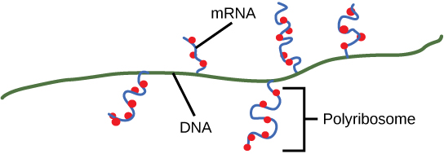
Figure 15.9
Multiple polymerases can transcribe a single bacterial gene while numerous ribosomes concurrently translate the mRNA transcripts into polypeptides. In this way, a specific protein can rapidly reach a high concentration in the bacterial cell.

Slide 11
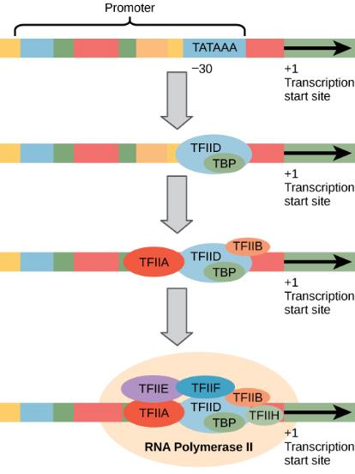
Figure 15.10
A generalized promoter of a gene transcribed by RNA polymerase II is shown. Transcription factors recognize the promoter. RNA polymerase II then binds and forms the transcription initiation complex.

Slide 12
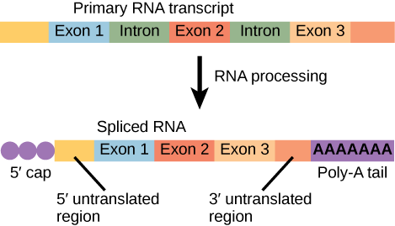
Figure 15.11
Eukaryotic mRNA contains introns that must be spliced out. A 5' cap and 3' poly-A tail are also added.

Slide 13
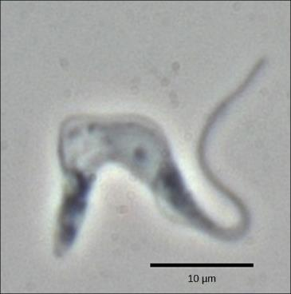
Figure 15.12
Trypanosoma brucei is the causative agent of sleeping sickness in humans. The mRNAs of this pathogen must be modified by the addition of nucleotides before protein synthesis can occur. (credit: modification of work by Torsten Ochsenreiter)

Slide 14
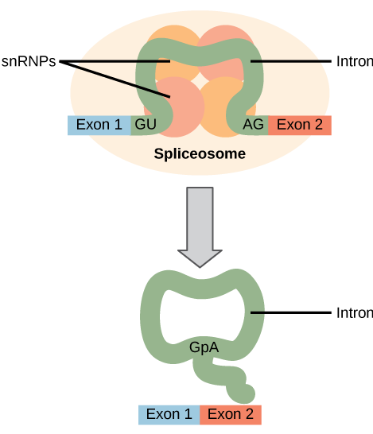
Figure 15.13
Pre-mRNA splicing involves the precise removal of introns from the primary RNA transcript. The splicing process is catalyzed by protein complexes called spliceosomes that are composed of proteins and RNA molecules called snRNAs. Spliceosomes recognize sequences at the 5' and 3' end of the intron.

Slide 15
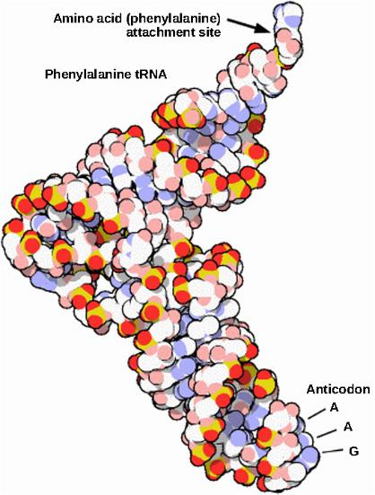
Figure 15.14
This is a space-filling model of a tRNA molecule that adds the amino acid phenylalanine to a growing polypeptide chain. The anticodon AAG binds the Codon UUC on the mRNA. The amino acid phenylalanine is attached to the other end of the tRNA.

Slide 16
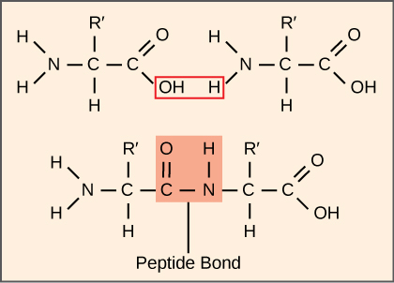
Figure 15.15
A peptide bond links the carboxyl end of one amino acid with the amino end of another, expelling one water molecule. For simplicity in this image, only the functional groups involved in the peptide bond are shown. The R and R' designations refer to the rest of each amino acid structure.

Slide 17
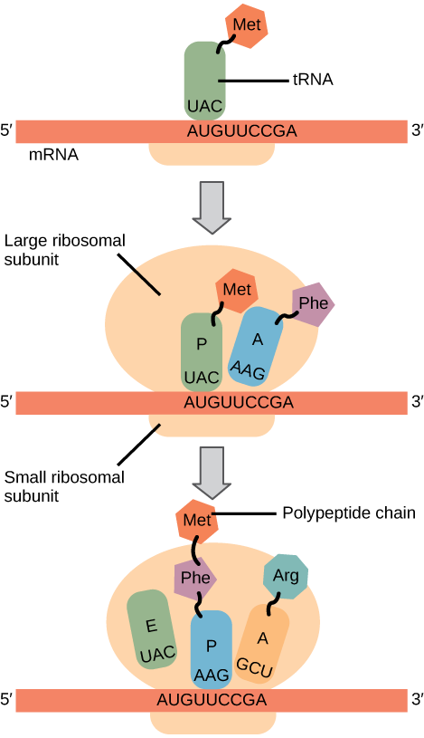
Figure 15.16
Translation begins when an initiator tRNA anticodon recognizes a codon on mRNA. The large ribosomal subunit joins the small subunit, and a second tRNA is recruited. As the mRNA moves relative to the ribosome, the polypeptide chain is formed. Entry of a release factor into the A site terminates translation and the components dissociate.

