Slide 1
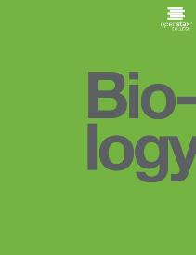
BIOLOGY
Chapter 11 MEIOSIS AND SEXUAL REPRODUCTION
PowerPoint Image Slideshow

Slide 2
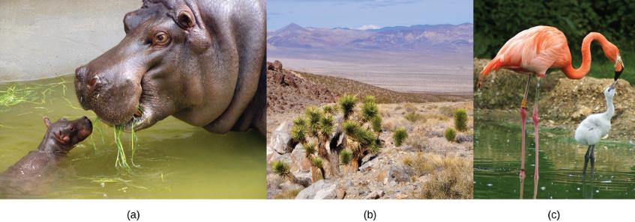
Figure 11.1
Each of us, like these other large multicellular organisms, begins life as a fertilized egg. After trillions of cell divisions, each of us develops into a complex, multicellular organism. (credit a: modification of work by Frank Wouters; credit b: modification of work by Ken Cole, USGS; credit c: modification of work by Martin Pettitt)

Slide 3
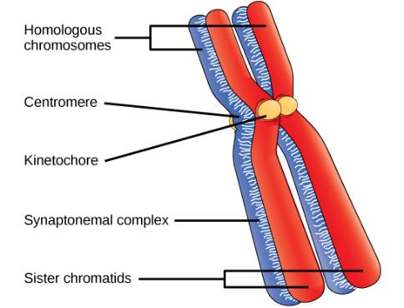
Figure 11.2
Early in prophase I, homologous chromosomes come together to form a synapse. The chromosomes are bound tightly together and in perfect alignment by a protein lattice called a synaptonemal complex and by cohesin proteins at the centromere.

Slide 4
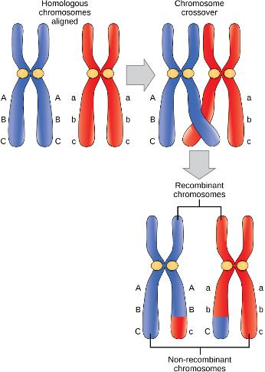
Figure 11.3
Crossover occurs between non-sister chromatids of homologous chromosomes. The result is an exchange of genetic material between homologous chromosomes.

Slide 5
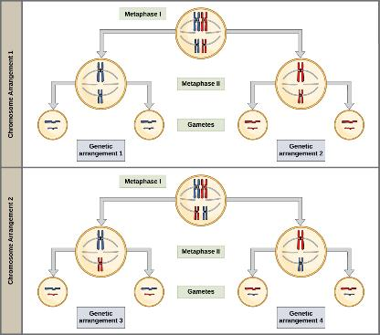
Figure 11.4
Random, independent assortment during metaphase I can be demonstrated by considering a cell with a set of two chromosomes (n = 2). In this case, there are two possible arrangements at the equatorial plane in metaphase I. The total possible number of different gametes is 2n, where n equals the number of chromosomes in a set. In this example, there are four possible genetic combinations for the gametes. With n = 23 in human cells, there are over 8 million possible combinations of paternal and maternal chromosomes

Slide 6
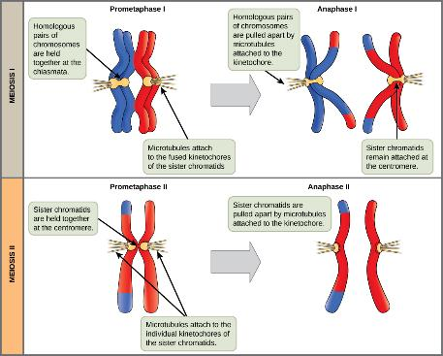
Figure 11.5
The process of chromosome alignment differs between meiosis I and meiosis II. In prometaphase I, microtubules attach to the fused kinetochores of homologous chromosomes, and the homologous chromosomes are arranged at the midpoint of the cell in metaphase I. In anaphase I, the homologous chromosomes are separated. In prometaphase II, microtubules attach to the kinetochores of sister chromatids, and the sister chromatids are arranged at the midpoint of the cells in metaphase II. In anaphase II, the sister chromatids are separated.

Slide 7
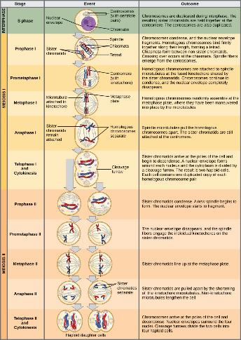
Figure 11.6
An animal cell with a diploid number of four (2n = 4) proceeds through the stages of meiosis to form four haploid daughter cells.

Slide 8
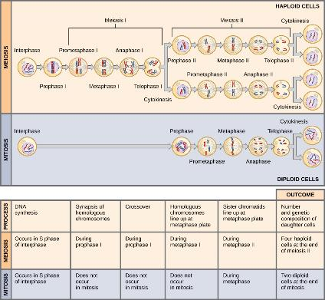
Figure 11.7
Meiosis and mitosis are both preceded by one round of DNA replication; however, meiosis includes two nuclear divisions. The four daughter cells resulting from meiosis are haploid and genetically distinct. The daughter cells resulting from mitosis are diploid and identical to the parent cell.

Slide 9
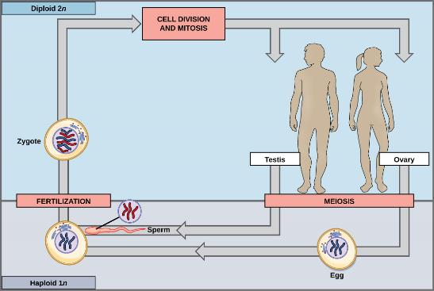
Figure 11.8
In animals, sexually reproducing adults form haploid gametes from diploid germ cells. Fusion of the gametes gives rise to a fertilized egg cell, or zygote. The zygote will undergo multiple rounds of mitosis to produce a multicellular offspring. The germ cells are generated early in the development of the zygote.

Slide 10
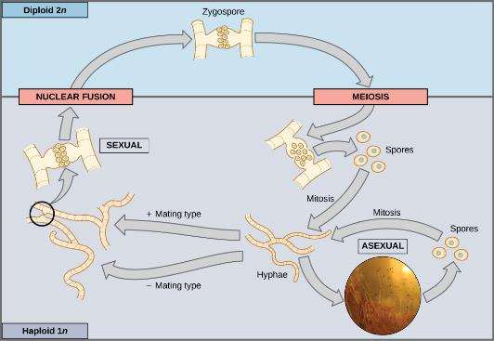
Figure 11.9
Fungi, such as black bread mold (Rhizopus nigricans), have haploid-dominant life cycles. The haploid multicellular stage produces specialized haploid cells by mitosis that fuse to form a diploid zygote. The zygote undergoes meiosis to produce haploid spores. Each spore gives rise to a multicellular haploid organism by mitosis. (credit “zygomycota” micrograph: modification of work by “Fanaberka”/Wikimedia Commons)

Slide 11
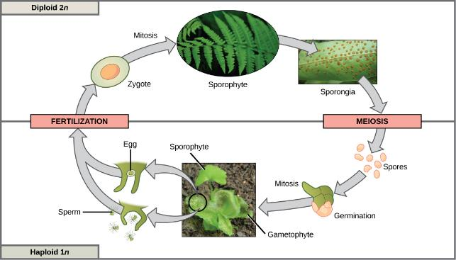
Figure 11.10
Plants have a life cycle that alternates between a multicellular haploid organism and a multicellular diploid organism. In some plants, such as ferns, both the haploid and diploid plant stages are free-living. The diploid plant is called a sporophyte because it produces haploid spores by meiosis. The spores develop into multicellular, haploid plants called gametophytes because they produce gametes. The gametes of two individuals will fuse to form a diploid zygote that becomes the sporophyte. (credit “fern”: modification of work by Cory Zanker; credit “sporangia”: modification of work by "Obsidian Soul"/Wikimedia Commons; credit “gametophyte and sporophyte”: modification of work by “Vlmastra”/Wikimedia Commons)

