Slide 1
Biology
Chapter 20 PHYLOGENIES AND THE HISTORY OF LIFE
PowerPoint Image Slideshow

Slide 2
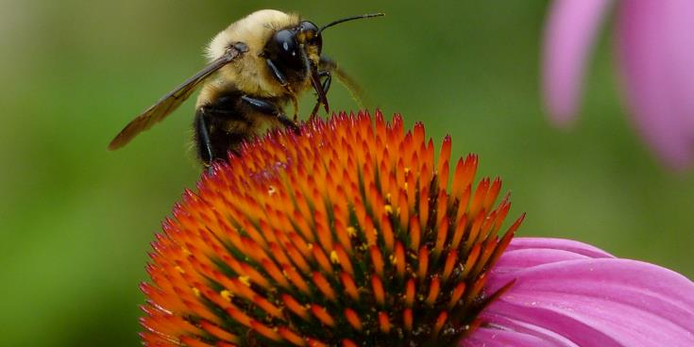
Figure 20.1
The life of a bee is very different from the life of a flower, but the two organisms are related. Both are members the domain Eukarya and have cells containing many similar organelles, genes, and proteins. (credit: modification of work by John Beetham)

Slide 3
Figure 20.2
Both of these phylogenetic trees shows the relationship of the three domains of life—Bacteria, Archaea, and Eukarya—but the (a) rooted tree attempts to identify when various species diverged from a common ancestor while the (b) unrooted tree does not. (credit a: modification of work by Eric Gaba)

Slide 4
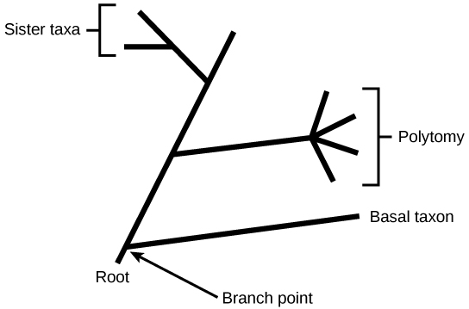
Figure 20.3
The root of a phylogenetic tree indicates that an ancestral lineage gave rise to all organisms on the tree. A branch point indicates where two lineages diverged. A lineage that evolved early and remains unbranched is a basal taxon. When two lineages stem from the same branch point, they are sister taxa. A branch with more than two lineages is a polytomy.

Slide 5
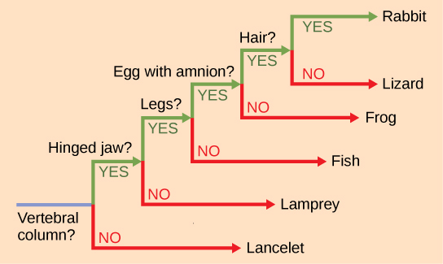
Figure 20.4
This ladder-like phylogenetic tree of vertebrates is rooted by an organism that lacked a vertebral column. At each branch point, organisms with different characters are placed in different groups based on the characteristics they share.

Slide 6
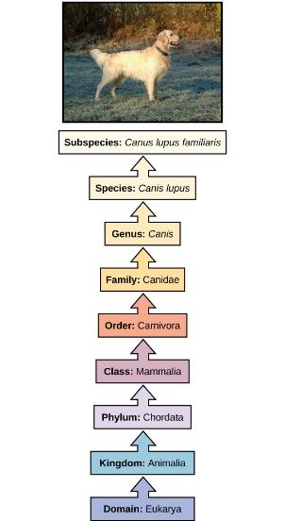
Figure 20.5
The taxonomic classification system uses a hierarchical model to organize living organisms into increasingly specific categories. The common dog, Canis lupus familiaris, is a subspecies of Canis lupus, which also includes the wolf and dingo. (credit “dog”: modification of work by Janneke Vreugdenhil)

Slide 7
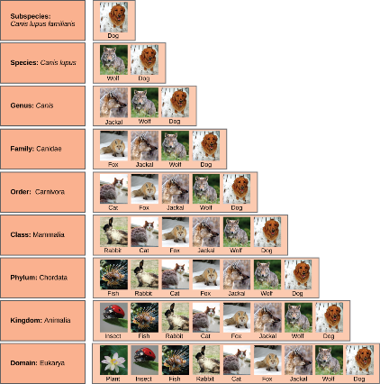
Figure 20.6
At each sublevel in the taxonomic classification system, organisms become more similar. Dogs and wolves are the same species because they can breed and produce viable offspring, but they are different enough to be classified as different subspecies. (credit “plant”: modification of work by “berduchwal”/Flickr; credit “insect”: modification of work by Jon Sullivan; credit “fish”: modification of work by Christian Mehlführer; credit “rabbit”: modification of work by Aidan Wojtas; credit “cat”: modification of work by Jonathan Lidbeck; credit “fox”: modification of work by Kevin Bacher, NPS; credit “jackal”: modification of work by Thomas A. Hermann, NBII, USGS; credit “wolf”: modification of work by Robert Dewar; credit “dog”: modification of work by “digital_image_fan”/Flickr)

Slide 8
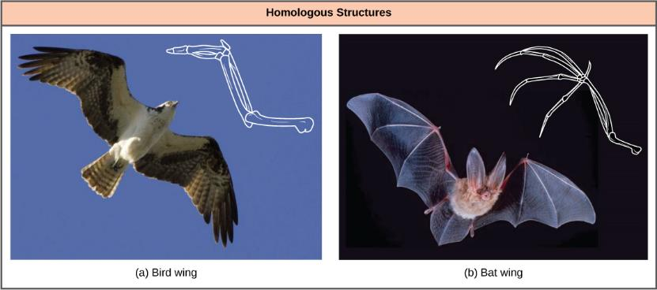
Figure 20.7
Bat and bird wings are homologous structures, indicating that bats and birds share a common evolutionary past. (credit a: modification of work by Steve Hillebrand, USFWS; credit b: modification of work by U.S. DOI BLM)

Slide 9
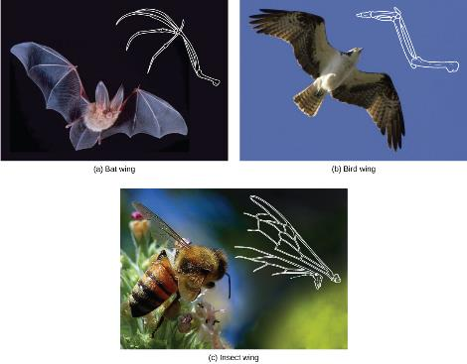
Figure 20.8
The (c) wing of a honeybee is similar in shape to a (b) bird wing and (a) bat wing, and it serves the same function. However, the honeybee wing is not composed of bones and has a distinctly different structure and embryonic origin. These wing types (insect versus bat and bird) illustrate an analogy—similar structures that do not share an evolutionary history. (credit a: modification of work by Steve Hillebrand, USFWS; credit b: modification of work by U.S. DOI BLM; credit c: modification of work by Jon Sullivan)

Slide 10
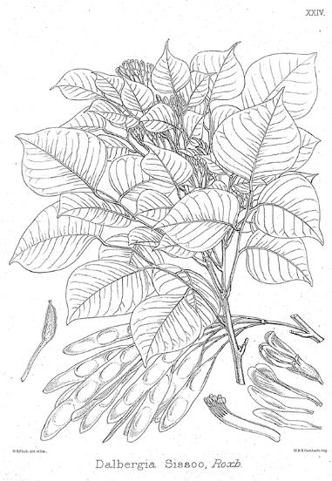
Figure 20.9
Dalbergia sissoo (D. sissoo) is in the Fabaceae, or legume family. Scientists found that D. sissoo shares a DNA marker with species within the Fabaceae family that have antifungal properties. Subsequently, D. sissoo was shown to have fungicidal activity, supporting the idea that DNA markers can be used to screen for plants with potential medicinal properties.

Slide 11
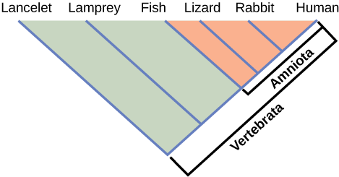
Figure 20.10
Lizards, rabbits, and humans all descend from a common ancestor that had an amniotic egg. Thus, lizards, rabbits, and humans all belong to the clade Amniota. Vertebrata is a larger clade that also includes fish and lamprey.

Slide 12
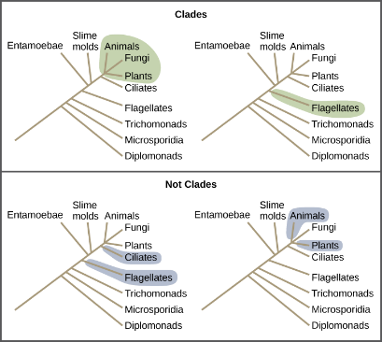
Figure 20.11
All the organisms within a clade stem from a single point on the tree. A clade may contain multiple groups, as in the case of animals, fungi and plants, or a single group, as in the case of flagellates. Groups that diverge at a different branch point, or that do not include all groups in a single branch point, are not considered clades.

Slide 13
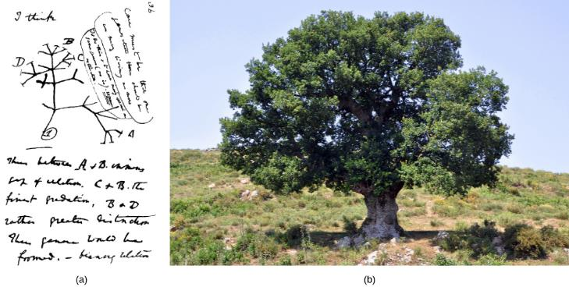
Figure 20.12
The (a) concept of the “tree of life” goes back to an 1837 sketch by Charles Darwin. Like an (b) oak tree, the “tree of life” has a single trunk and many branches. (credit b: modification of work by “Amada44”/Wikimedia Commons)

Slide 14
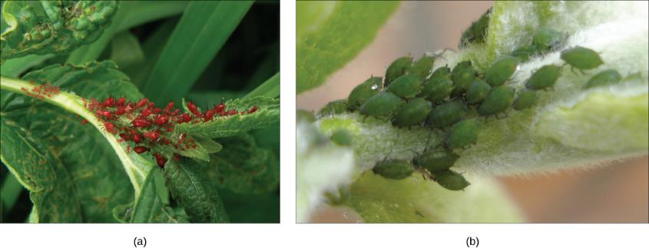
Figure 20.13
(a) Red aphids get their color from red carotenoid pigment. Genes necessary to make this pigment are present in certain fungi, and scientists speculate that aphids acquired these genes through HGT after consuming fungi for food. If genes for making carotenoids are inactivated by mutation, the aphids revert back to (b) their green color. Red coloration makes the aphids a lot more conspicuous to predators, but evidence suggests that red aphids are more resistant to insecticides than green ones. Thus, red aphids may be more fit to survive in some environments than green ones. (credit a: modification of work by Benny Mazur; credit b: modification of work by Mick Talbot)

Slide 15
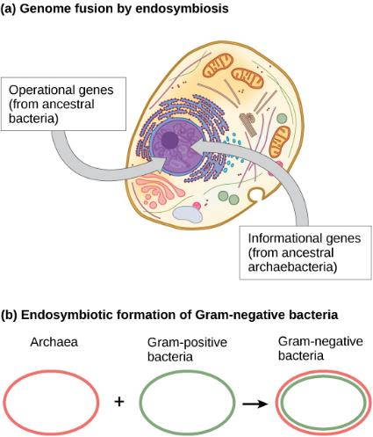
Figure 20.14
The theory that mitochondria and chloroplasts are endosymbiotic in origin is now widely accepted. More controversial is the proposal that (a) the eukaryotic nucleus resulted from the fusion of archaeal and bacterial genomes, and that (b) Gram-negative bacteria, which have two membranes, resulted from the fusion of Archaea and Gram-positive bacteria, each of which has a single membrane.

Slide 16
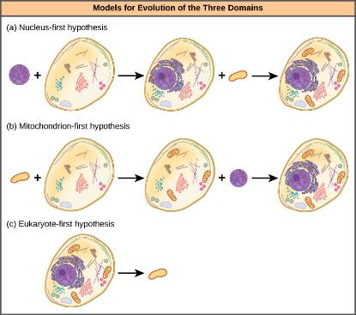
Figure 20.15
Three alternate hypotheses of eukaryotic and prokaryotic evolution are (a) the nucleusfirst hypothesis, (b) the mitochondrion-first hypothesis, and (c) the eukaryote-first hypothesis.

Slide 17
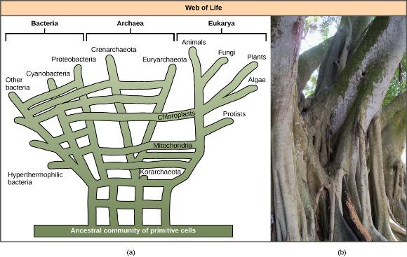
Figure 20.16
In the (a) phylogenetic model proposed by W. Ford Doolittle, the “tree of life” arose from a community of ancestral cells, has multiple trunks, and has connections between branches where horizontal gene transfer has occurred. Visually, this concept is better represented by (b) the multi-trunked Ficus than by the single trunk of the oak similar to the tree drawn by Darwin Figure 20.12. (credit b: modification of work by “psyberartist”/Flickr)

Slide 18
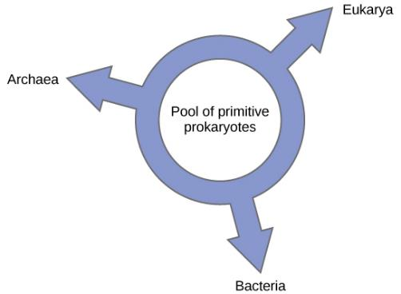
Figure 20.17
According to the “ring of life” phylogenetic model, the three domains of life evolved from a pool of primitive prokaryotes.

