Slide 1
INTRODUCTION TO SOCIOLOGy 2E
Chapter 18 WORK AND THE ECONOMY
PowerPoint Image Slideshow

Slide 2
Figure 18.1
Today, employees are working harder than ever in offices and other places of employement. (Photo courtesy of Juhan Sonin/flickr)

Slide 3
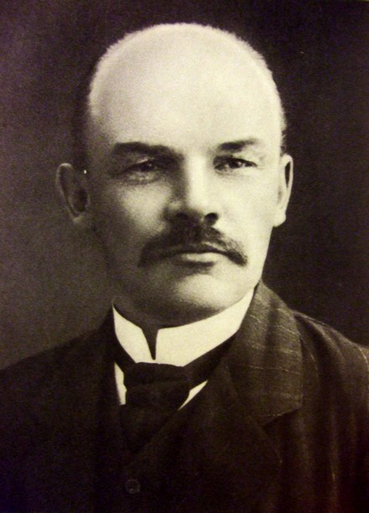
Figure 18.2
Vladimir Ilyich Lenin was one of the founders of Russian communism. J.P. Morgan was one of the most influential capitalists in history. They have very different views on how economies should be run. (Photos (a) and (b) courtesy of Wikimedia Commons)

Slide 4
Figure 18.3
In an agricultural economy, crops and seeds are the most important commodity. In a postindustrial society, information is the most valuable resource. (Photo (a) courtesy of Edward S. Curtis/Wikimedia Commons. Photo (b) courtesy of Kārlis Dambrāns/flickr)

Slide 5
Figure 18.4
Agricultural practices have emerged in different societies at different times. (Information courtesy of Wikimedia Commons)

Slide 6
Figure 18.5
The New York Stock Exchange is where shares of stock in companies that are registered for public trading are traded (Photo courtesy of Ryan Lawler/Wikimedia Commons)

Slide 7
Figure 18.6
The economies of China and Russia after World War II are examples of one form of socialism. (Photo courtesy of Wikimedia Commons)

Slide 8
Figure 18.7
This map shows countries that have adopted a socialist economy at some point. The colors indicate the duration that socialism prevailed. (Map courtesy of the European Union)

Slide 9
Figure 18.8
Sociologists look for signs of convergence and divergence in the societies of countries that have joined the European Union. (Map courtesy of the European Union)

Slide 10
Figure 18.9
Instant communications have allowed many international corporations to move parts of their businesses to countries such as India, where their costs are lowest. (Photo courtesy of Wikimedia Commons)

Slide 11
Figure 18.10
Many people attend job fairs looking for their first job or for a better one. (Photo courtesy of Daniel Ramirez/flickr)

Slide 12
Figure 18.11
In a virtual world, living the good life still costs real money. (Photo courtesy of Juan Pablo Amo/flickr)

Slide 13
Figure 18.12
This chart shows the projected growth of several occupational groups. (Graph courtesy of the Bureau of Labor Statistics Occupational Outlook Handbook)

Slide 14
Figure 18.13
More education means more jobs (generally). (Graph courtesy of the U.S. Department of Labor)

Slide 15
Figure 18.14
A higher percentage of the people living in poverty in the United States have jobs compared to other developed nations.

Slide 16
Figure 18.15
Poverty Rates by Age: 1959 to 2010 While poverty rates among the elderly have fallen, an increasing number of children are living in poverty. (Graph courtesy of the U.S. Census Burea/Carmen DeNavas-Walt and Bernadette D. Proctor, Income and Poverty in the United States 2010)

