Slide 1
INTRODUCTION TO SOCIOLOGY 2E
Chapter 14 MARRIAGE AND FAMILY
PowerPoint Image Slideshow

Slide 2
Figure 14.1
What constitutes a family nowadays? (Photo courtesy of Michael/flickr)

Slide 3
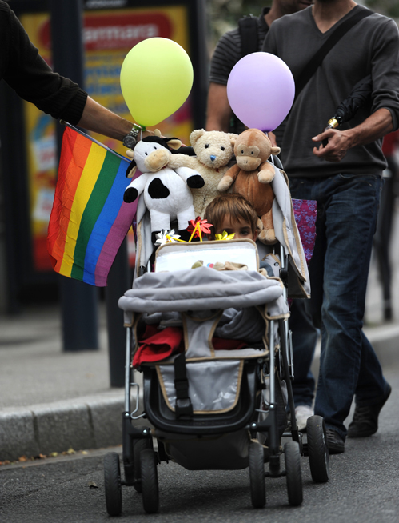
Figure 14.2
The modern concept of family is far more encompassing than in past decades. What do you think constitutes a family? (Photo (a) courtesy Gareth Williams/flickr; photo (b) courtesy Guillaume Paumier/ Wikimedia Commons)

Slide 4
Figure 14.3
Joseph Smith, Jr., the founder of Mormonism, is said to have practiced polygamy. (Photo courtesy of public domain/Wikimedia Commons)

Slide 5
Figure 14.4
More than one quarter of U.S. children live in a single-parent household. (Photo courtesy of Ross Griff/ flickr)

Slide 6
Figure 14.5
As shown by this graph of marital status percentages among young adults, more young people are choosing to delay or opt out of marriage. (U.S. Census Bureau, 2000 Census and American Community Survey)

Slide 7
Figure 14.6
More and more people in the United States are choosing lifestyles that don’t include marriage. (Photo courtesy of Glenn Harper/flickr)

Slide 8
Figure 14.7
A study from Radford University indicated that bartenders are among the professions with the highest divorce rates (38.4 percent). Other traditionally low-wage industries (like restaurant service, custodial employment, and factory work) are also associated with higher divorce rates. (Aamodt and McCoy 2010). (Photo courtesy of Daniel Lobo/flickr)

Slide 9
Figure 14.8
Thirty percent of women who are murdered are killed by their intimate partner. What does this statistic reveal about societal patterns and norms concerning intimate relationships and gender roles? (Photo courtesy of Kathy Kimpel/flickr)

Slide 10
Figure 14.9
The Casey Anthony trial, in which Casey was ultimately acquitted of murder charges against her daughter, Caylee, created public outrage and brought to light issues of child abuse and neglect across the United States. (Photo courtesy of Bruce Tuten/flickr)

