Slide 1
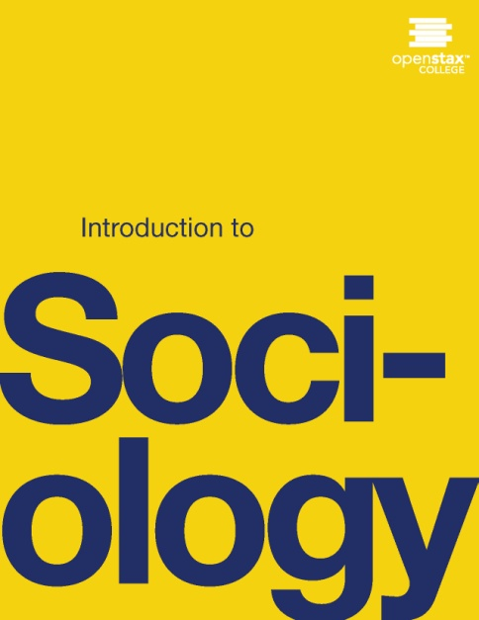
INTRODUCTION TO SOCIOLOGY 2E
Chapter 3 CULTURE
PowerPoint Image Slideshow

Slide 2
Figure 3.1
People adhere to various rules and standards that are created and maintained in culture, such as giving a high five to someone. (Photo courtesy of Chris Barnes/flickr)

Slide 3
Figure 3.2
How would a visitor from the suburban United States act and feel on this crowded Tokyo train? (Photo courtesy of simonglucas/flickr)

Slide 4
Figure 3.3
Experiencing new cultures offers an opportunity to practice cultural relativism. (Photo courtesy of OledSidorenko/flickr)

Slide 5
Figure 3.4
In many parts of Africa and the Middle East, it is considered normal for men to hold hands in friendship. How would Americans react to these two soldiers? (Photo courtesy of Geordie Mott/Wikimedia Commons)

Slide 6
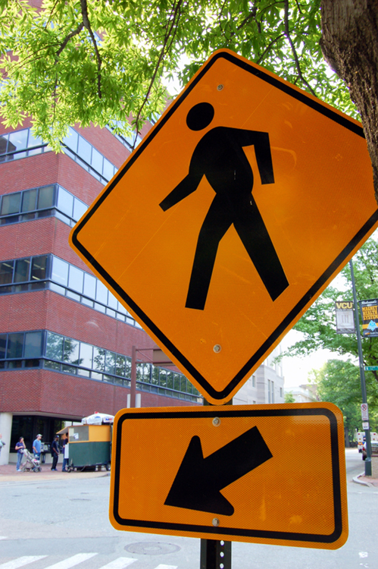
Figure 3.5
Some road signs are universal. But how would you interpret the signage on the right? (Photo (a) courtesy of Andrew Bain/flickr; Photo (b) courtesy of HonzaSoukup/flickr)

Slide 7
Figure 3.6
Nowadays, many signs—on streets and in stores—include both English and Spanish. What effect does this have on members of society? What effect does it have on our culture? (Photo courtesy of istolethetv/flickr)

Slide 8
Figure 3.7
In the 1940s, U.S. hipsters were associated with the “cool” culture of jazz. (Photo courtesy of William P. Gottlieb/Ira and Leonore S. Gershwin Fund Collection, Music Division, Library of Congress)

Slide 9
Figure 3.8
Intellectual and trendy, today’s hipsters define themselves through cultural irony. (Photo courtesy of Lorena Cupcake/Wikimedia Commons)

Slide 10
Figure 3.9
Sociologist Everett Rogers (1962) developed a model of the diffusion of innovations. As consumers gradually adopt a new innovation, the item grows toward a market share of 100 percent, or complete saturation within a society. (Graph courtesy of Tungsten/Wikimedia Commons)

Slide 11
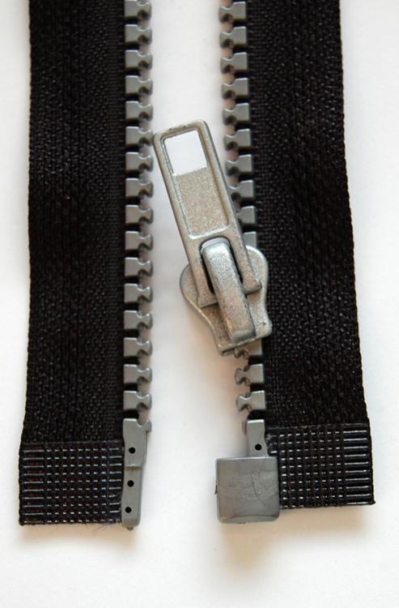
Figure 3.10
Officially patented in 1893 as the “clasp locker” (left), the zipper did not diffuse through society for many decades. Today, it is immediately recognizable around the world. (Photo (a) courtesy of U.S. Patent Office/Wikimedia Commons; Photo (b) courtesy of Rabensteiner/Wikimedia Commons)

Slide 12
Figure 3.11
This statue of Superman stands in the center of Metropolis, Illinois. His pedestal reads “Truth—Justice—The American Way.” How would a functionalist interpret this statue? What does it reveal about the values of American culture? (Photo courtesy of David Wilson/flickr)

Slide 13
Figure 3.12
This child’s clothing may be culturally specific, but her facial expression is universal. (Photo courtesy of Beth Rankin/flickr)

