Slide 1
INTRODUCTION TO SOCIOLoGY 2E
Chapter 6 GROUPS AND ORGANIZATION
PowerPoint Image Slideshow

Slide 2
Figure 6.1
The national tour of the Tea Party Express visited Minnesota and held a rally outside the state capitol building. (Photo courtesy of Fibonacci Blue/flickr)

Slide 3
Figure 6.2
Engineering and construction students gather around a job site. How do your academic interests define your in- and out-groups? (Photo courtesy of USACEpublicaffairs/flickr)

Slide 4
Figure 6.3
Athletes are often viewed as a reference group for young people. (Photo courtesy of Johnny Bivera/U.S. Navy/ Wikimedia Commons)

Slide 5
Figure 6.4
Which fraternity or sorority would you fit into, if any? Sorority recruitment day offers students an opportunity to learn about these different groups. (Photo courtesy of Murray State/flickr)

Slide 6
Figure 6.5
Cadets illustrate how strongly conformity can define groups. (Photo courtesy David Spender/flickr)

Slide 7
Figure 6.6
Presidential candidate Hillary Clinton drew fire for her leadership style. (Photo courtesy marcn/flickr)

Slide 8
Figure 6.7
This gag gift demonstrates how female leaders may be viewed if they violate social norms. (Photo courtesy of istolethetv/flickr)

Slide 9
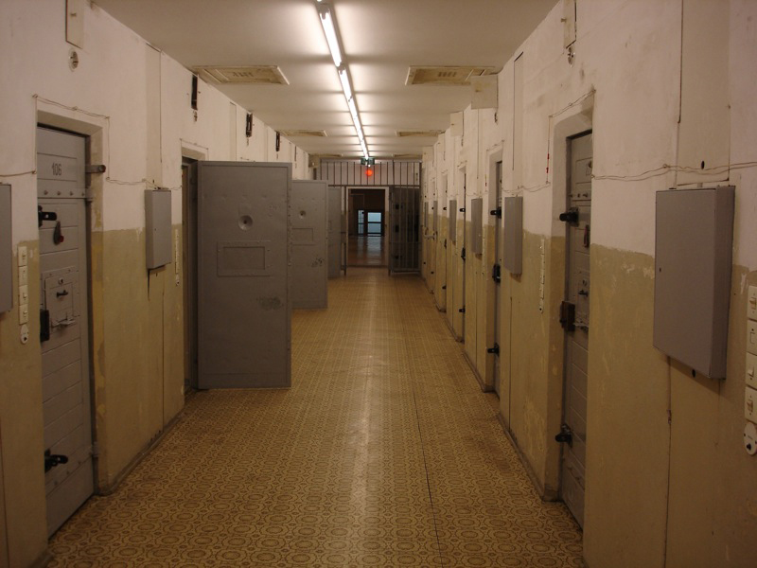
Figure 6.8
Girl Scout troops and correctional facilities are both formal organizations. (Photo (a) courtesy of moonlightbulb/flickr; Photo (b) courtesy of CxOxS/flickr)

Slide 10
Figure 6.9
This McDonald’s storefront in Egypt shows the McDonaldization of society. (Photo courtesy of s_w_ellis/flickr)

Slide 11
Figure 6.10
Fast-food jobs are expected to grow more quickly than most industries. (Graph courtesy of U.S. BLS)

