Slide 1
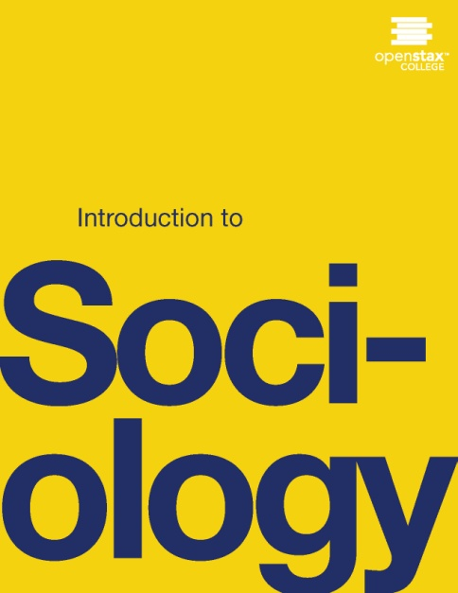
INTRODUCTION TO SOCIOLOGY 2E
Chapter 17 GOVERNMENT AND POLITICS
PowerPoint Image Slideshow

Slide 2
Figure 17.1
In 2011, thousands of Egyptian citizens demonstrated in the streets and protested political repression by Egyptian President Hosni Mubarak (Photo courtesy of Jonathan Rashad/flickr

Slide 3
Figure 17.2
The White House, one of the world’s most widely recognized state buildings, symbolizes the authority of the U.S. presidency. (Courtesy U.S. National Archives/Wikimedia Commons)

Slide 4
Figure 17.3
Nazi leader Adolf Hitler was one of the most powerful and destructive dictators in modern history. He is pictured here with fascist Benito Mussolini of Italy. (Photo courtesy of U.S. National Archives and Records Administration)

Slide 5
Figure 17.4
Young people and students were among the most ardent supporters of democratic reform in the recent Arab Spring. Social media also played an important role in rallying grassroots support. (Photo courtesy of cjb22/flickr)

Slide 6
Figure 17.5
Former Iraqi dictator Saddam Hussein used fear and intimidation to keep citizens in check. (Photo courtesy of Brian Hillegas/flickr)

Slide 7
Figure 17.6
Queen Noor of Jordan is the dowager queen of this constitutional monarchy and has limited political authority. Queen Noor is American by birth, but relinquished her citizenship when she married. She is a noted global advocate for Arab-Western relations. (Photo courtesy of Skoll World Forum/flickr)

Slide 8
Figure 17.7
The Breakers, the famous Newport, Rhode Island, home of the Vanderbilts, is a powerful symbol of the extravagant wealth that characterized the Gilded Age. (Photo courtesy of ckramer/flickr)

Slide 9
Figure 17.8
Dictator Kim Jong-Il of North Korea was a charismatic leader of an absolute dictatorship. His followers responded emotionally to the death of their leader in 2011. (Photo courtesy of babeltrave/flickr)

Slide 10
Figure 17.9
Americans' voting rights are a fundamental element of the U.S. democratic structure. (Photo courtesy of David Goehring/flickr)

Slide 11
Figure 17.10
Although military technology has evolved considerably over the course of history, the fundamental causes of conflict among nations remain essentially the same. (Photo courtesy of Wikimedia Commons)

Slide 12
Figure 17.11
What symbols of the Boston Tea Party are represented in this painting? How might a symbolic interactionist explain the way the modern-day Tea Party has reclaimed and repurposed these symbolic meanings? (Photo courtesy of Wikimedia Commons)

