Slide 1
INTRODUCTION TO SOCIOLOGY 2E
Chapter 9 SOCIAL STRATIFICATION IN THE UNITED STATES
PowerPoint Image Slideshow

Slide 2
Figure 9.1
This house, formerly owned by the famous television producer, Aaron Spelling, was for a time listed for $150 million dollars. It is considered one of the most extravagant homes in the United States, and is a testament to the wealth generated in some industries. (Photo courtesy of Atwater Village Newbie/flickr)

Slide 3
Figure 9.2
In the upper echelons of the working world, people with the most power reach the top. These people make the decisions and earn the most money. The majority of Americans will never see the view from the top. (Photo courtesy of Alex Proimos/flickr)

Slide 4
Figure 9.3
Strata in rock illustrate social stratification. People are sorted, or layered, into social categories. Many factors determine a person’s social standing, such as income, education, occupation, as well as age, race, gender, and even physical abilities. (Photo courtesy of Just a Prairie Boy/flickr)

Slide 5
Figure 9.4
The people who live in these houses most likely share similar levels of income and education. Neighborhoods often house people of the same social standing. Wealthy families do not typically live next door to poorer families, though this varies depending on the particular city and country. (Photo courtesy of Orin Zebest/flickr)

Slide 6
Figure 9.5
India used to have a rigid caste system. The people in the lowest caste suffered from extreme poverty and were shunned by society. Some aspects of India’s defunct caste system remain socially relevant. In this photo, an Indian woman of a specific Hindu caste works in construction, and she demolishes and builds houses. (Photo courtesy of Elessar/flickr)

Slide 7
Figure 9.6
Prince William, Duke of Cambridge, who is in line to be king of England, married Catherine Middleton, a so-called commoner, meaning she does not have royal ancestry. (Photo courtesy of humberpike/flickr)

Slide 8
Figure 9.7
Does taste or fashion sense indicate class? Is there any way to tell if this young man comes from an upper-, middle-, or lower-class background? (Photo courtesy of Kelly Bailey/flickr)

Slide 9
Figure 9.8
Members of the upper class can afford to live, work, and play in exclusive places designed for luxury and comfort. (Photo courtesy of PrimeImageMedia.com/flickr)

Slide 10
Figure 9.9
These members of a club likely consider themselves middle class. (Photo courtesy of United Way Canada- Centraide Canada/flickr)

Slide 11
Figure 9.10
This man is a custodian at a restaurant. His job, which is crucial to the business, is considered lower class. (Photo courtesy of Frederick Md Publicity/flickr)

Slide 12
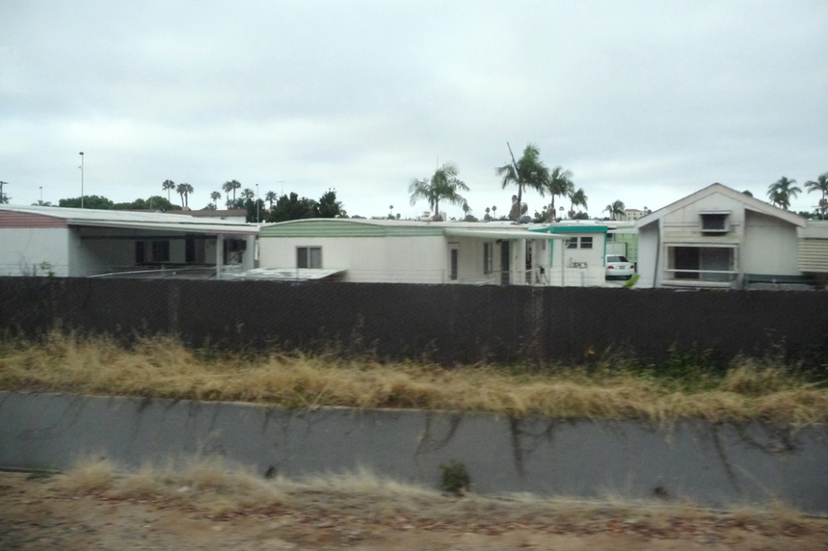
Figure 9.11
A family lives in this grass hut in Ethiopia. Another family lives in a single-wide trailer in the trailer park in the United States. Both families are considered poor, or lower class. With such differences in global stratification, what constitutes poverty? (Photo (a) courtesy of Canned Muffins/flickr; Photo (b) courtesy of Herb Neufeld/flickr)

Slide 13
Figure 9.12
Luxury vacation resorts can contribute to a poorer country’s economy. This one, in Jamaica, attracts middle and upper-middle class people from wealthier nations. The resort is a source of income and provides jobs for local people. Just outside its borders, however, are poverty-stricken neighborhoods. (Photo courtesy of gailf548/flickr)

Slide 14
Figure 9.13
These people are protesting a decision made by Tennessee Technological University in Cookeville, Tennessee, to lay off custodians and outsource the jobs to a private firm to avoid paying employee benefits. Private job agencies often pay lower hourly wages. Is the decision fair? (Photo courtesy of Brian Stansberry/Wikimedia Commons)

Slide 15
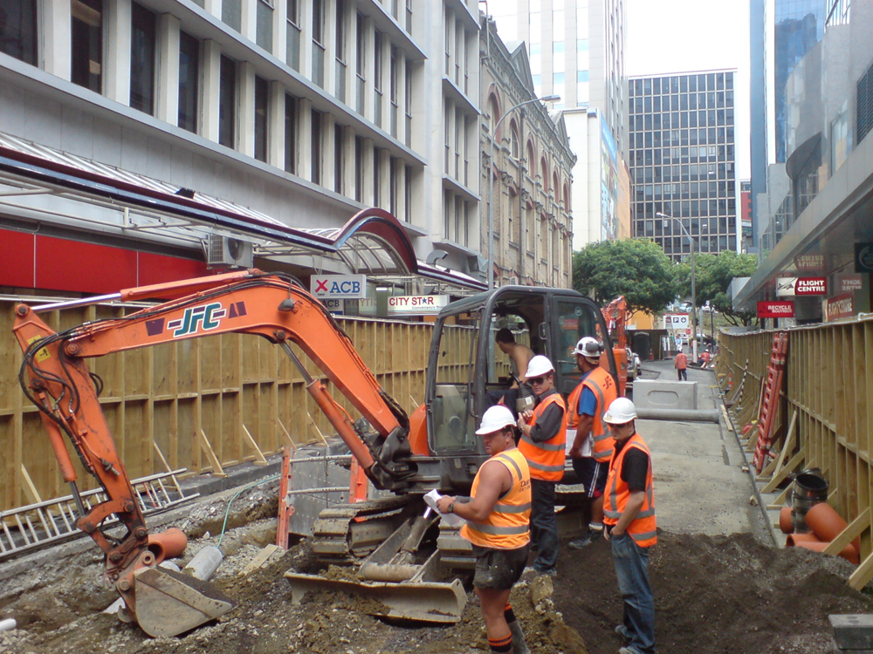
Figure 9.14
a) A group of construction workers on the job site, and b) a group of businessmen.
What categories of stratification do these construction workers share? How do construction workers differ from executives or custodians? Who is more skilled? Who has greater prestige in society? (Photo (a) courtesy of Wikimedia Commons; Photo (b) courtesy of Chun Kit/flickr)

