Slide 1
INTRODUCTION TO SOCIOLOGY 2E
Chapter 4 SOCIETY AND SOCIAL INTERACTION
PowerPoint Image Slideshow

Slide 2
Figure 4.1
Sociologists study how societies interact with the environment and how they use technology. (Photo courtesty of Garry Knight/flickr)

Slide 3
Figure 4.2
How does technology influence a society's daily occupations? (Photo courtesy of Mo Riza/flickr)

Slide 4
Figure 4.3
Otherwise skeptic or hesitant villagers are more easily convinced of the value of the solar project when they realize that the “solar engineers” are their local grandmothers. (Photo courtesy of Abri le Roux/flickr)

Slide 5
Figure 4.4
John D. Rockefeller, cofounder of the Standard Oil Company, came from an unremarkable family of salesmen and menial laborers. By his death at age 98, he was worth $1.4 billion. In industrial societies, business owners such as Rockefeller hold the majority of the power. (Photo courtesy of Wikimedia Commons)

Slide 6
Figure 4.5
Warren Buffett’s ideas about taxation and spending habits of the very wealthy are controversial, particularly since they raise questions about America’s embedded system of class structure and social power. The three major sociological paradigms differ in their perspectives on these issues. (Photo courtesy of Medill DC/flickr)

Slide 7
Figure 4.6
Karl Marx asserted that all elements of a society’s structure depend on its economic structure.

Slide 8
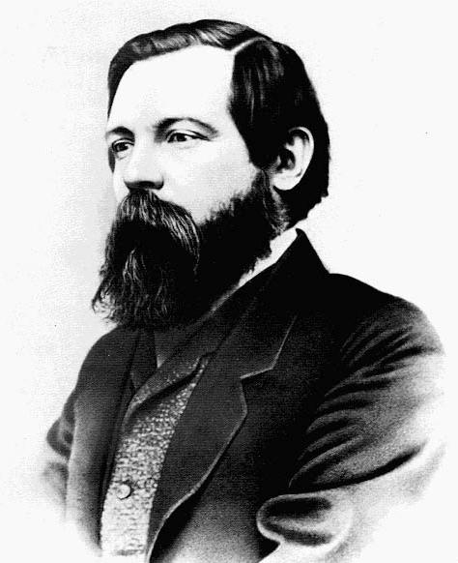
Figure 4.7
Karl Marx (left) and Friedrich Engels (right) analyzed differences in social power between “have” and “have-not” groups. (Photo (a) courtesy of Wikimedia Commons; Photo (b) courtesy of George Lester/Wikimedia Commons)

Slide 9
Figure 4.8
An assembly line worker installs car parts with the aid of complex machinery. Has technology made this type of labor more or less alienating? (Photo courtesy of Carol Highsmith/Wikimedia Commons)

Slide 10
Figure 4.9
Cubicles are used to maximize individual workspace in an office. Such structures may be rational, but they are also isolating. (Photo courtesy of Tim Patterson/flickr)

Slide 11
Figure 4.10
Who are we? What role do we play in society? According to sociologists, we construct reality through our interactions with others. In a way, our day-to-day interactions are like those of actors on a stage. (Photo courtesy of Jan Lewandowski/flickr)

Slide 12
Figure 4.11
The story line of a self-fulfilling prophecy appears in many literary works, perhaps most famously in the story of Oedipus. Oedipus is told by an oracle that he will murder his father and marry his mother. In going out of his way to avoid his fate, Oedipus inadvertently fulfills it. Oedipus’s story illustrates one way in which members of society contribute to the social construction of reality. (Photo courtesy of Jean-Antoine-Theodore Giroust/Wikimedia Commons)

Slide 13
Figure 4.12
Janus, another possible “prop”, depicted with two heads, exemplifies war and peace. (Photo courtesy of Fubar Obfusco/Wikimedia Commons)

