Slide 1
INTRODUCTION TO SOCIOLOGY 2E
Chapter 7 DEVIANCE, CRIME, AND SOCIAL CONTROL
PowerPoint Image Slideshow

Slide 2
Figure 7.1
Washington is one of several states where marijuana use has been legalized, decriminalized, or approved for medical use. (Photo courtesy of Dominic Simpson/flickr)

Slide 3
Figure 7.2
Much of the appeal of watching entertainers perform in drag comes from the humor inherent in seeing everyday norms violated. (Photo courtesy of Cassiopeija/Wikimedia Commons)

Slide 4
Figure 7.3
A hearse with the license plate “LASTRYD.” How would you view the owner of this car? (Photo courtesy of Brian Teutsch/flickr)

Slide 5
Figure 7.4
Functionalists believe that deviance plays an important role in society and can be used to challenge people’s views. Protesters, such as these PETA members, often use this method to draw attention to their cause. (Photo courtesy of David Shankbone/flickr).

Slide 6
Figure 7.5
Proponents of social disorganization theory believe that individuals who grow up in impoverished areas are more likely to participate in deviant or criminal behaviors. (Photo courtesy of Apollo 1758/Wikimedia Commons)

Slide 7
Figure 7.6
From 1986 until 2010, the punishment for possessing crack, a “poor person’s drug,” was 100 times stricter than the punishment for cocaine use, a drug favored by the wealthy. (Photo courtesy of Wikimedia Commons)

Slide 8
Figure 7.7
Should a former felony conviction permanently strip a U.S. citizen of the right to vote? (Photo courtesy of Joshin Yamada/flickr).

Slide 9
Figure 7.8
How is a crime different from other types of deviance? (Photo courtesy of Duffman/Wikimedia Commons.)

Slide 10
Figure 7.9
In the United States, there were 8,336 reported victims of hate crimes in 2009. This represents less than five percent of the number of people who claimed to be victims of hate crimes when surveyed. (Graph courtesy of FBI 2010)

Slide 11
Figure 7.10
Here, Afghan National Police Crisis Response Unit members train in Surobi, Afghanistan. (Photo courtesy of isafmedia/flickr)

Slide 12
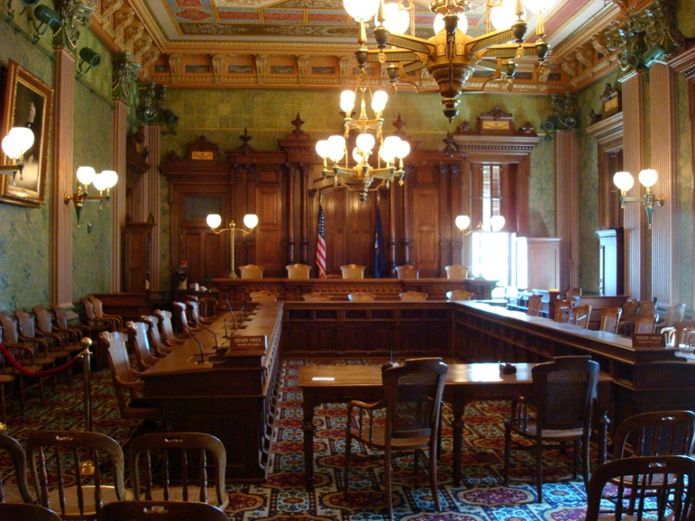
Figure 7.11
This county courthouse in Kansas (left) is a typical setting for a state trial court. Compare this to the courtroom of the Michigan Supreme Court (right). (Photo (a) courtesy of Ammodramus/Wikimedia Commons; Photo (b) courtesy of Steve & Christine/Wikimedia Commons)

