Slide 1
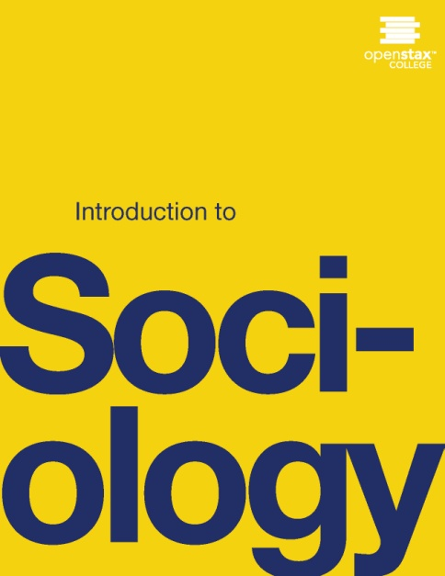
INTRODUCTION TO SOCIOLOGY 2E
Chapter 12 GENDER, SEX AND SEXUALITY
PowerPoint Image Slideshow

Slide 2
Figure 12.1
Some children may learn at an early age that their gender does not correspond with their sex. (Photo courtesy of Rajesh Kumar/flickr)

Slide 3
Figure 12.2
While the biological differences between males and females are fairly straightforward, the social and cultural aspects of being a man or woman can be complicated. (Photo courtesy of FaceMePLS/flickr)

Slide 4
Figure 12.3
The Kinsey scale indicates that sexuality can be measured by more than just heterosexuality and homosexuality.

Slide 5
Figure 12.4
Fathers tend to be more involved when their sons engage in gender-appropriate activities such as sports. (Photo courtesy of Shawn Lea/flickr)

Slide 6
Figure 12.5
Chaz Bono is the transgender son of Cher and Sonny Bono. While he was born female, he considers himself male. Being transgender is not about clothing or hairstyles; it is about self-perception. (Photo courtesy of Greg Hernandez/flickr)

Slide 7
Figure 12.6
Traditional images of U.S. gender roles reinforce the idea that women should be subordinate to men. (Photo courtesy of Sport Suburban/flickr)

Slide 8
Figure 12.7
Although our society may have a stereotype that associates motorcycles with men, female bikers demonstrate that a woman’s place extends far beyond the kitchen in the modern United States. (Photo courtesy of Robert Couse-Baker/flickr)

Slide 9
Figure 12.8
In some cultures, women do all of the household chores with no help from men, as doing housework is a sign of weakness, considered by society as a feminine trait. (Photo courtesy of Evil Erin/flickr)

Slide 10
Figure 12.9
Sexual practices can differ greatly among groups. Recent trends include the finding that married couples have sex more frequently than do singles and that 27 percent of married couples in their 30s have sex at least twice a week (NSSHB 2010). (Photo courtesy of epSos.de/flickr)

