Slide 1
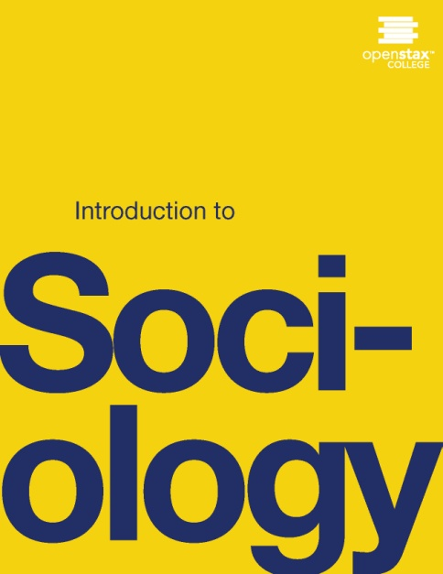
INTRODUCTION TO SOCIOLOGY 2E
Chapter 21 SOCIAL MOVEMENTS AND SOCIAL CHANGE
PowerPoint Image Slideshow

Slide 2
Figure 21.1
In many ways, this mask, which perhaps became infamous due to its use by the "hacktivist" group Anonymous, has come to stand for revolution and social change around the world. (Photo courtesy of Coco Curranski/flickr)

Slide 3
Figure 21.2
Is this a good time had by all? Some flash mobs may function as political protests, while others are for fun. This flash mob pillow fight’s purpose was to entertain. (Photo courtesy of Mattwi1S0n:/flickr)

Slide 4
Figure 21.3
According to the emergent-norm perspective, Hurricane Katrina victims sought needed supplies for survival, but to outsiders their behavior would normally be seen as looting. (Photo courtesy of Infrogmation/Wikimedia Commons)

Slide 5
Figure 21.4
Agents of social control bring collective behavior to an end. (Photo courtesy of hozinja/flickr)

Slide 6
Figure 21.5
Texas Secede! is an organization which would like Texas to secede from the United States. (Photo courtesy of Tim Pearce/flickr)

Slide 7
Figure 21.6
At the time of this writing, more than thirty states and the District of Columbia allow marriage for same-sex couples. State constitutional bans are more difficult to overturn than mere state bans because of the higher threshold of votes required to change a constitution. Now that the Supreme Court has stricken a key part of the Defense of Marriage Act, same-sex couples married in states that allow it are now entitled to federal benefits afforded to heterosexual couples (CNN 2014). (Photo courtesy of Jose Antonio Navas/flickr)

Slide 8
Figure 21.7
In 2008, Obama’s campaign used social media to tweet, like, and friend its way to victory. (Photos courtesy of bradleyolin/flickr)

Slide 9
Figure 21.8
After a devastating earthquake in 2010, Twitter and the Red Cross raised millions for Haiti relief efforts through phone donations alone. (Photo courtesy of Cambodia4KidsOrg/flickr)

Slide 10
Figure 21.9
Multiple social movement organizations concerned about the same issue form a social movement industry. A society’s many social movement industries comprise its social movement sector. With so many options, to whom will you give your time and money?

Slide 11
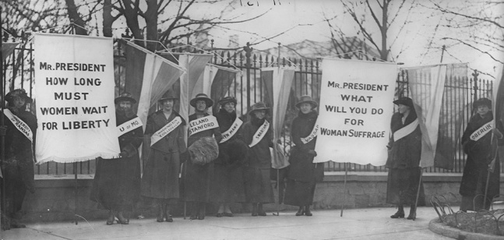
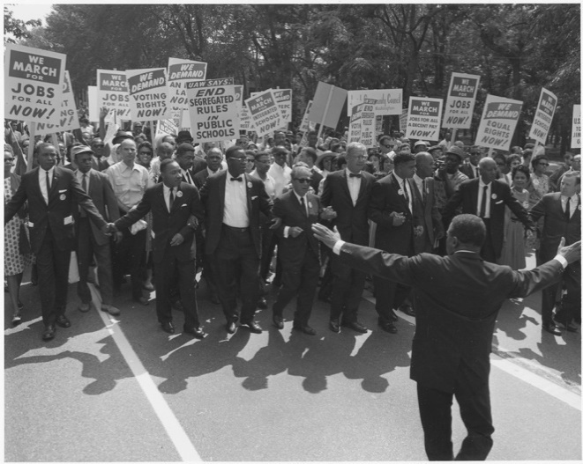
Figure 21.10
Extension occurs when social movements have sympathetic causes. Women’s rights, racial equality, and LGBT advocacy are all human rights issues. (Photos (a) and (b) courtesy of Wikimedia Commons; Photo (c) courtesy of Charlie Nguyen/flickr)

