Slide 1
CHEMISTRY
Chapter 13 Fundamental Equilibrium Concepts
PowerPoint Image Slideshow

Slide 2
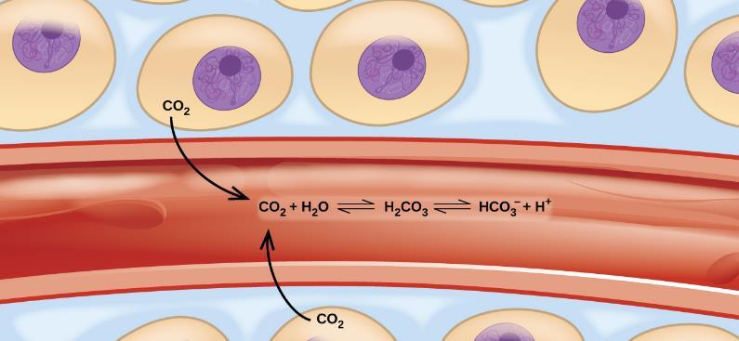
Figure 13.1
Movement of carbon dioxide through tissues and blood cells involves several equilibrium reactions.

Slide 3
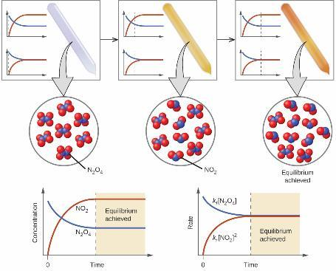
Figure 13.2
A mixture of NO₂ and N₂O₄ moves toward equilibrium. Colorless N₂O₄ reacts to form brown NO₂. As the reaction proceeds toward equilibrium, the color of the mixture darkens due to the increasing concentration of NO₂.

Slide 4
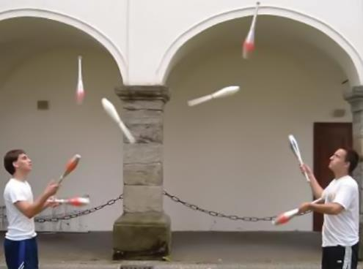
Figure 13.3
These jugglers provide an illustration of dynamic equilibrium. Each throws clubs to the other at the same rate at which he receives clubs from that person. Because clubs are thrown continuously in both directions, the number of clubs moving in each direction is constant, and the number of clubs each juggler has at a given time remains (roughly) constant.

Slide 5
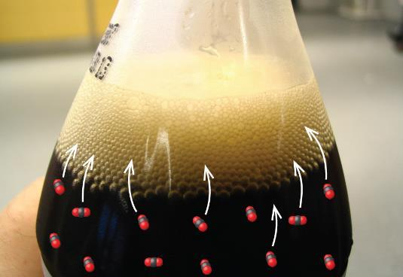
Figure 13.4
When a soft drink is opened, several equilibrium shifts occur. (credit: modification of work by “D Coetzee”/Flickr)

Slide 6
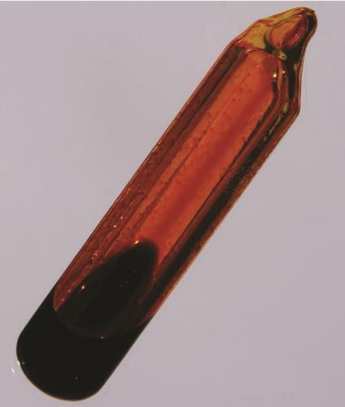
Figure 13.5
An equilibrium is pictured between liquid bromine, Br₂ (l), the dark liquid, and bromine vapor, Br₂(g), the orange gas. Because the container is sealed, bromine vapor cannot escape and equilibrium is maintained. (credit: http://images-of-elements.com/bromine.php)

Slide 7
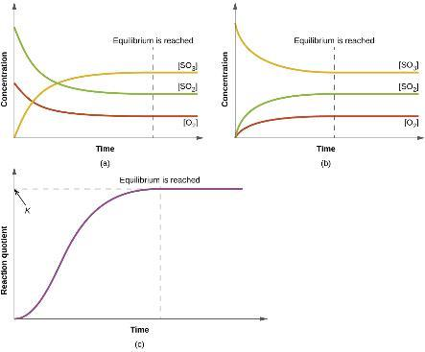
Figure 13.6
The change in the concentrations of reactants and products is depicted as the 2SO₂(g) + O₂ (g) ⇌ 2SO₃ (g) reaction approaches equilibrium.
The change in concentrations of reactants and products is depicted as the reaction 2SO₃(g) ⇌ 2SO₂ (g) + O₂ (g) approaches equilibrium.
The graph shows the change in the value of the reaction quotient as the reaction approaches equilibrium.

Slide 8
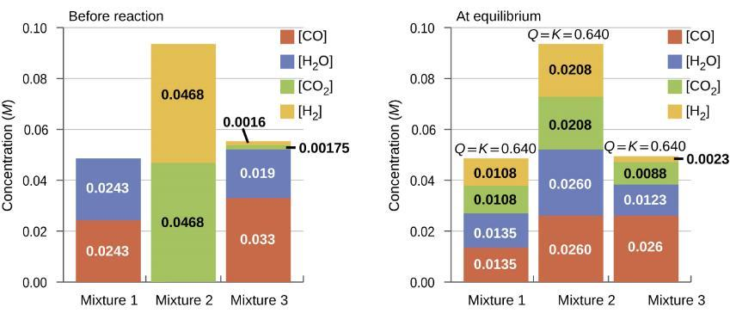
Figure 13.7
Concentrations of three mixtures are shown before and after reaching equilibrium at 800 °C for the so called water gas shift reaction: CO(g) + H₂O(g) ⇌ CO₂ (g) + H₂ (g).

Slide 9
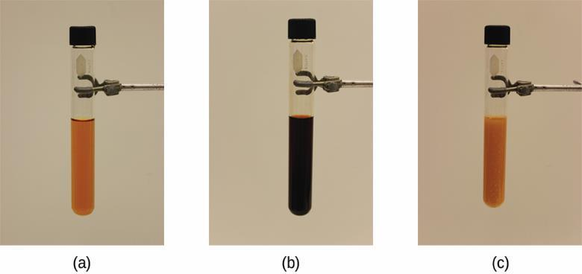
Figure 13.8
The test tube contains 0.1 M Fe³⁺.
Thiocyanate ion has been added to solution in (a), forming the red Fe(SCN)²⁺ ion. Fe³⁺(aq) + SCN⁻(aq) ⇌ Fe(SCN)²⁺(aq).
Silver nitrate has been added to the solution in (b), precipitating some of the SCN− as the white solid AgSCN. Ag⁺(aq) + SCN⁻(aq) ⇌ AgSCN(s). The decrease in the SCN⁻ concentration shifts the first equilibrium in the solution to the left, decreasing the concentration (and lightening color) of the Fe(SCN)²⁺. (credit: modification of work by Mark Ott)

Slide 10
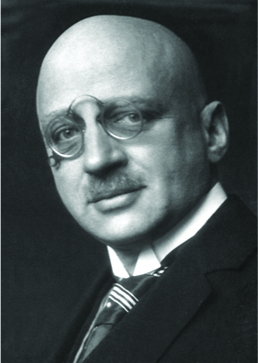
Figure 13.9
The work of Nobel Prize recipient Fritz Haber revolutionized agricultural practices in the early 20th century. His work also affected wartime strategies, adding chemical weapons to the artillery.

Slide 11
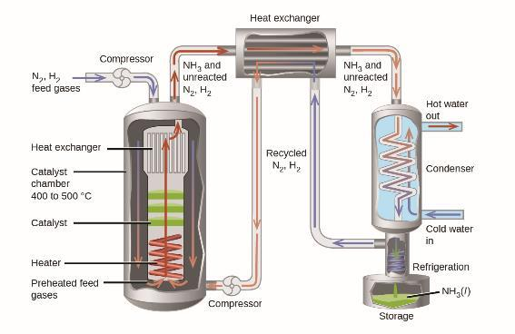
Figure 13.10
Commercial production of ammonia requires heavy equipment to handle the high temperatures and pressures required. This schematic outlines the design of an ammonia plant.

Slide 12
Exercise 86

Slide 13
Exercise 98

