Slide 1
CHEMISTRY
Appendix A THE PERIODIC TABLE
PowerPoint Image Slideshow

Slide 2
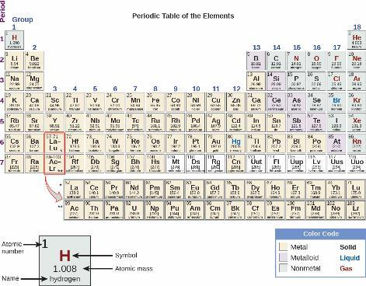
UNFIGURE 1

Slide 3
CHEMISTRY
Appendix B ESSENTIAL MATHEMATICS
PowerPoint Image Slideshow

Slide 4
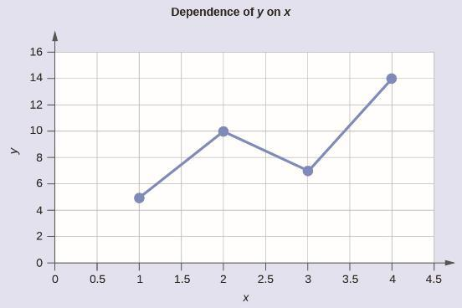
Example B11

Slide 5
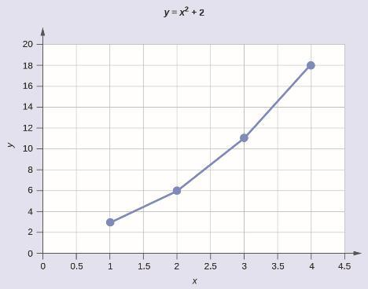
Example B12

Slide 6
CHEMISTRY
Appendix E WATER PROPERTIES
PowerPoint Image Slideshow

Slide 7
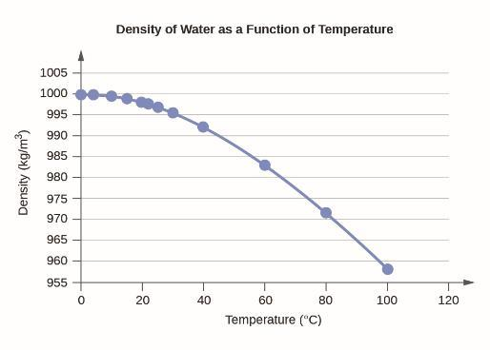
UNFIGURE 2

Slide 8
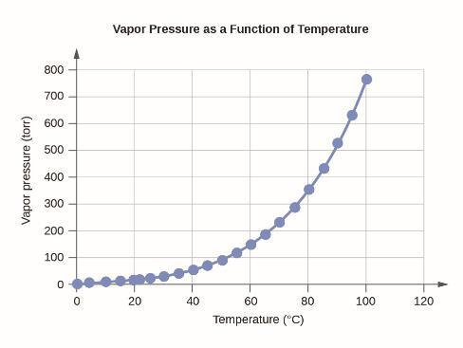
UNFIGURE 3

Slide 9
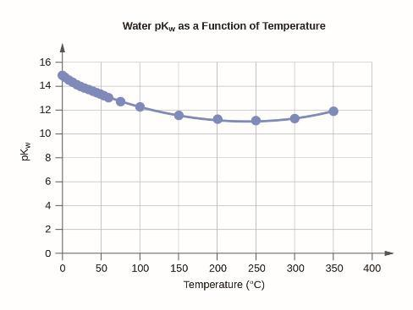
UNFIGURE 4

Slide 10
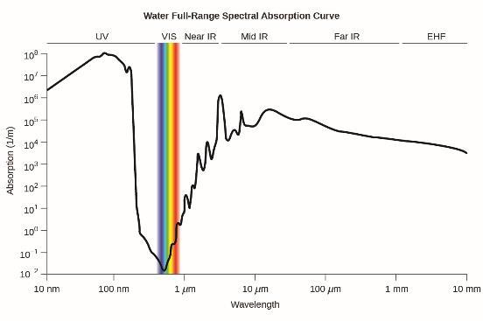
Figure E1
Water full-range spectral absorption curve. This curve shows the full-range spectral absorption for water. The y-axis signifies the absorption in 1/cm. If we divide 1 by this value, we will obtain the length of the path (in cm) after which the intensity of a light beam passing through water decays by a factor of the base of the natural logarithm e (e = 2.718281828).

