Slide 1
CHEMISTRY
Chapter 4 Stoichiometry of Chemical Reactions
PowerPoint Image Slideshow

Slide 2
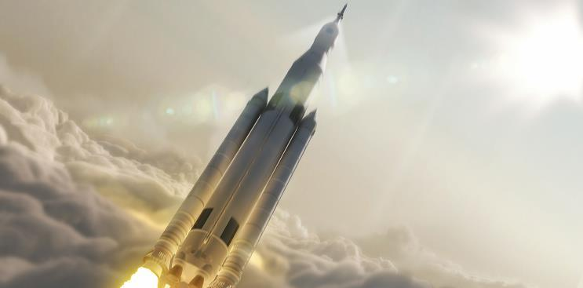
Figure 4.1
Many modern rocket fuels are solid mixtures of substances combined in carefully measured amounts and ignited to yield a thrust-generating chemical reaction. (credit: modification of work by NASA)

Slide 3
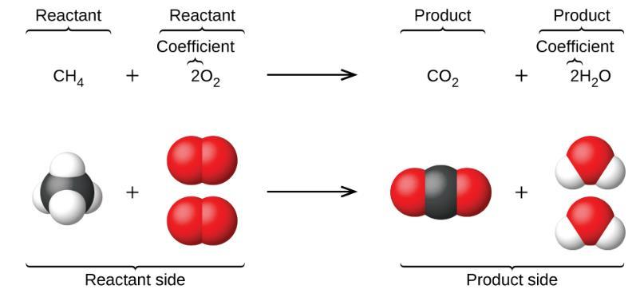
Figure 4.2
The reaction between methane and oxygen to yield carbon dioxide in water (shown at bottom) may be represented by a chemical equation using formulas (top).

Slide 4
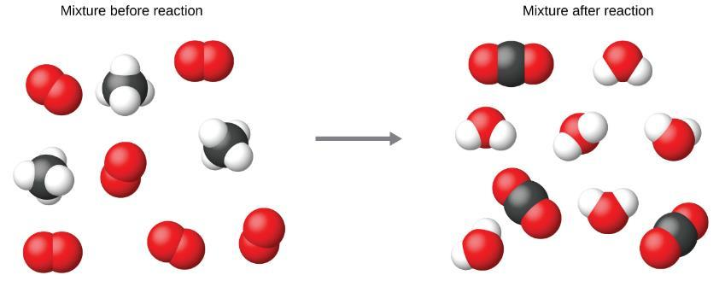
Figure 4.3
Regardless of the absolute number of molecules involved, the ratios between numbers of molecules are the same as that given in the chemical equation.

Slide 5
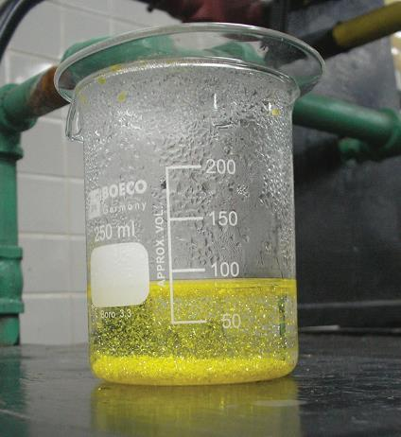
Figure 4.4
A precipitate of PbI₂ forms when solutions containing Pb²⁺ and I⁻ are mixed. (credit: Der Kreole/Wikimedia Commons)

Slide 6
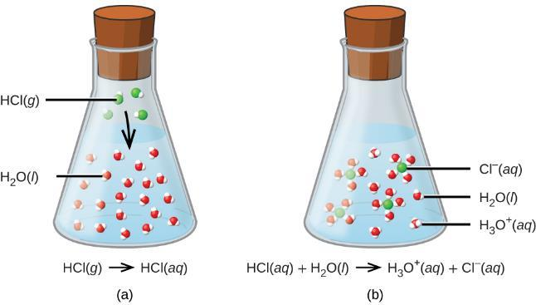
Figure 4.5
When hydrogen chloride gas dissolves in water, (a) it reacts as an acid, transferring protons to water molecules to yield (b) hydronium ions (and solvated chloride ions).

Slide 7
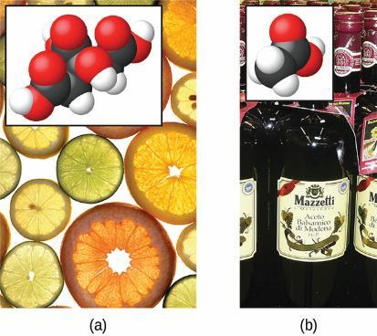
Figure 4.6
Fruits such as oranges, lemons, and grapefruit contain the weak acid citric acid.
Vinegars contain the weak acid acetic acid. The hydrogen atoms that may be transferred during an acid-base reaction are highlighted in the inset molecular structures. (credit a: modification of work by Scott Bauer; credit b: modification of work by Brücke-Osteuropa/Wikimedia Commons)

Slide 8
Figure 4.7
Ammonia is a weak base used in a variety of applications. (a) Pure ammonia is commonly applied as an agricultural fertilizer. (b) Dilute solutions of ammonia are effective household cleansers. (credit a: modification of work by National Resources Conservation Service; credit b: modification of work by pat00139)

Slide 9
Figure 4.8
(a) A copper wire is shown next to a solution containing silver(I) ions. (b) Displacement of dissolved silver ions by copper ions results in (c) accumulation of gray-colored silver metal on the wire and development of a blue color in the solution, due to dissolved copper ions. (credit: modification of work by Mark Ott)

Slide 10
Figure 4.9
Aluminum and iodine react to produce aluminum iodide. The heat of the reaction vaporizes some of the solid iodine as a purple vapor. (credit: modification of work by Mark Ott)

Slide 11
Example 4.8

Slide 12
Example 4.9

Slide 13
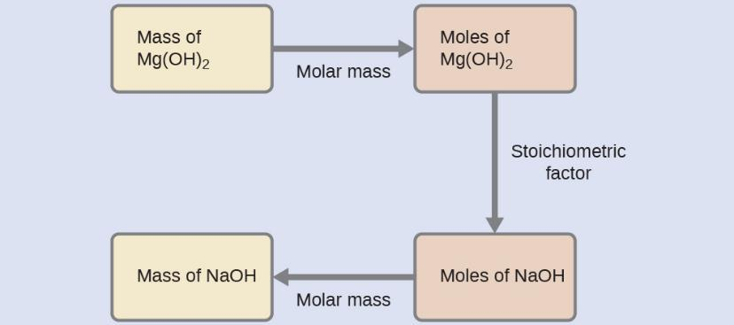
Example 4.10

Slide 14
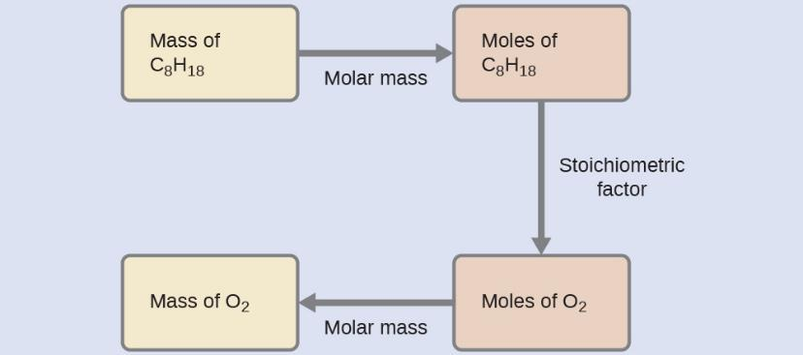
Example 4.11

Slide 15
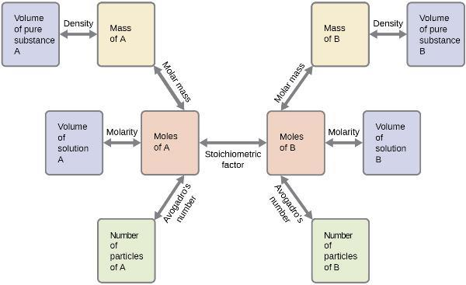
FIGURE 4.10
The flowchart depicts the various computational steps involved in most reaction stoichiometry calculations.

Slide 16
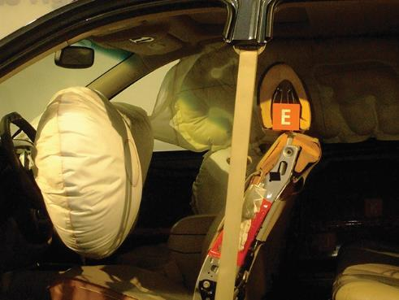
Figure 4.11
Airbags deploy upon impact to minimize serious injuries to passengers. (credit: Jon Seidman)

Slide 17
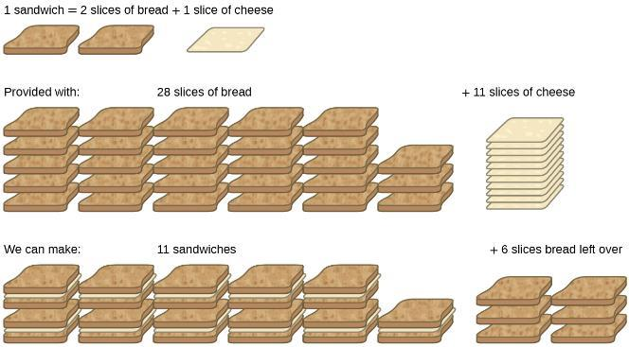
Figure 4.12
Sandwich making can illustrate the concepts of limiting and excess reactants.

Slide 18
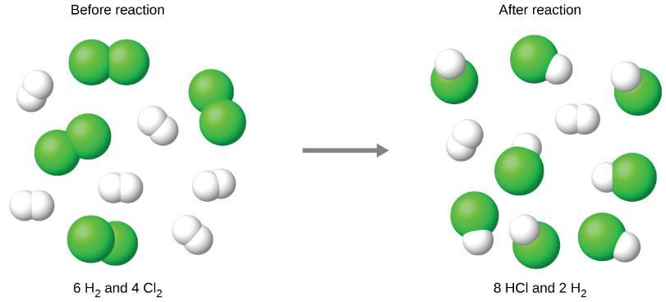
Figure 4.13
When H₂ and Cl₂ are combined in nonstoichiometric amounts, one of these reactants will limit the amount of HCl that can be produced. This illustration shows a reaction in which hydrogen is present in excess and chlorine is the limiting reactant.

Slide 19
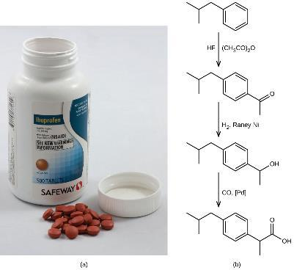
Figure 4.14
Ibuprofen is a popular nonprescription pain medication commonly sold as 200 mg tablets.
The BHC process for synthesizing ibuprofen requires only three steps and exhibits an impressive atom economy. (credit a: modification of work by Derrick Coetzee)

Slide 20
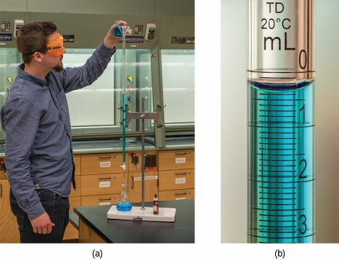
Figure 4.15
A student fills a buret in preparation for a titration analysis.
A typical buret permits volume measurements to the nearest 0.01 mL. (credit a: modification of work by Mark Blaser and Matt Evans; credit b: modification of work by Mark Blaser and Matt Evans)

Slide 21
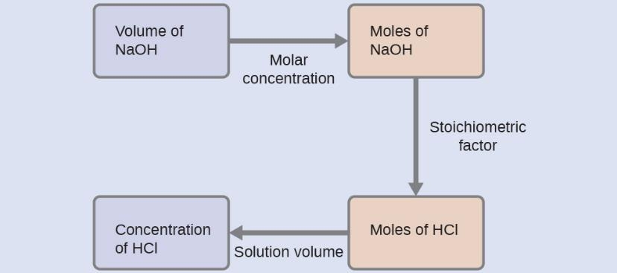
Example 4.14

Slide 22
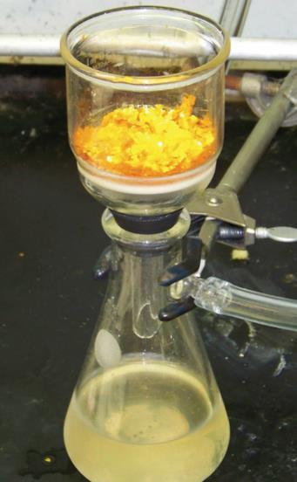
Figure 4.16
Precipitate may be removed from a reaction mixture by filtration.

Slide 23
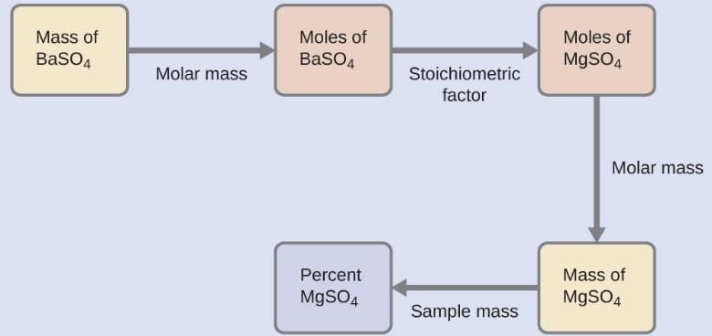
Example 4.15

Slide 24
Figure 4.17
This schematic diagram illustrates the basic components of a combustion analysis device for determining the carbon and hydrogen content of a sample.

Slide 25
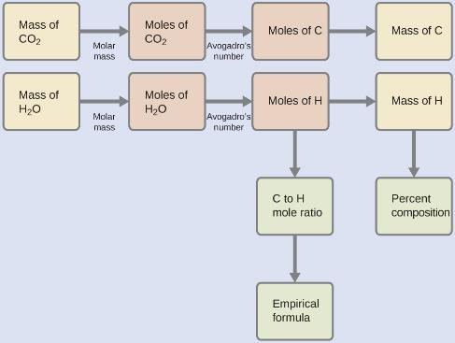
Example 4.16

Slide 26
Exercise 42f

Slide 27
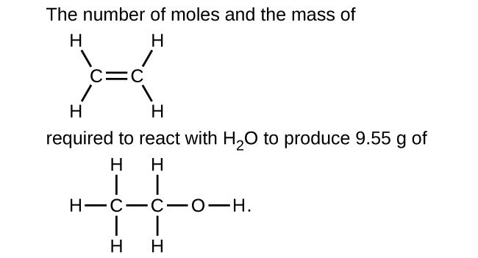
Exercise 44f

Slide 28
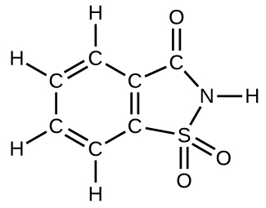
Exercise 75

Slide 29
Exercise 92

Slide 30
BLANK PAGE
This file is copyright 2015, Rice University. All Rights Reserved.

