Slide 1
CHEMISTRY
Chapter 16 Thermodynamics
PowerPoint Image Slideshow

Slide 2
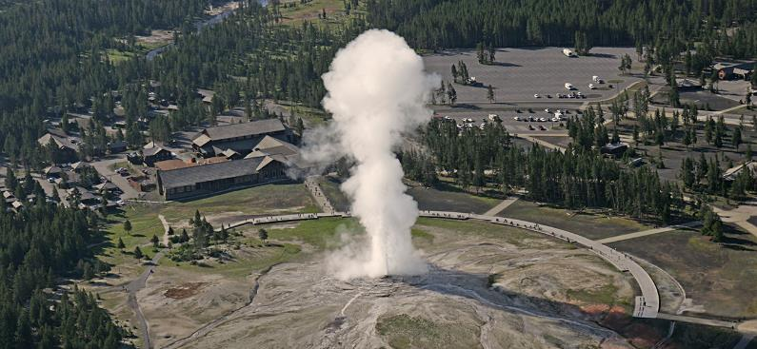
Figure 16.1
Geysers are a dramatic display of thermodynamic principles in nature. As water inside the earth heats up, it rises to the surface through small channels. Pressure builds up until the water turns to steam, and steam is expelled forcefully through a hole at the surface. (credit: modification of work by Yellowstone National Park)

Slide 3
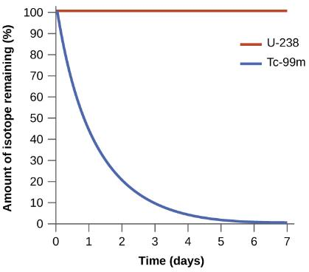
Figure 16.2
Both U-238 and Tc-99m undergo spontaneous radioactive decay, but at drastically different rates. Over the course of one week, essentially all of a Tc-99m sample and none of a U-238 sample will have decayed.

Slide 4
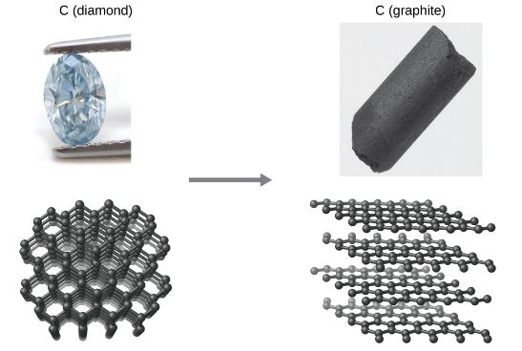
Figure 16.3
The conversion of carbon from the diamond allotrope to the graphite allotrope is spontaneous at ambient pressure, but its rate is immeasurably slow at low to moderate temperatures. This process is known as graphitization, and its rate can be increased to easily measurable values at temperatures in the 1000–2000 K range. (credit “diamond” photo: modification of work by “Fancy Diamonds”/Flickr; credit “graphite” photo: modificaton of work by images-of-elements.com/carbon.php)

Slide 5
Figure 16.4
An isolated system consists of an ideal gas in one flask that is connected by a closed valve to a second flask containing a vacuum. Once the valve is opened, the gas spontaneously becomes evenly distributed between the flasks.

Slide 6
Figure 16.5
When two objects at different temperatures come in contact, heat spontaneously flows from the hotter to the colder object.

Slide 7
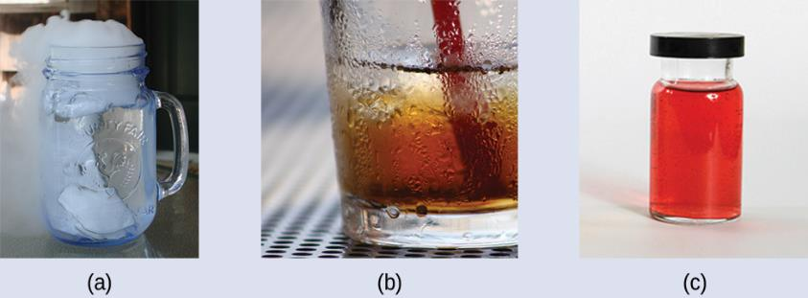
Figure 16.6
(credit a: modification of work by Jenny Downing; credit b: modification of work by “Fuzzy Gerdes”/Flickr; credit c: modification of work by Sahar Atwa)

Slide 8
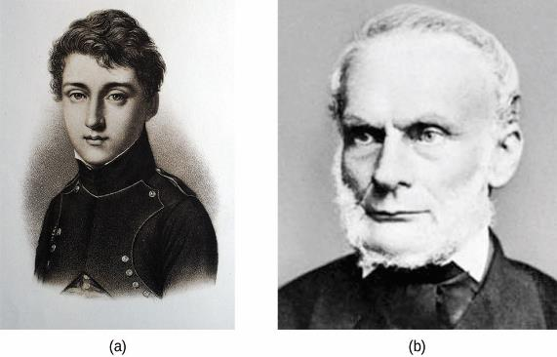
Figure 16.7
(a) Nicholas Léonard Sadi Carnot’s research into steam-powered machinery and (b) Rudolf Clausius’s later study of those findings led to groundbreaking discoveries about spontaneous heat flow processes.

Slide 9
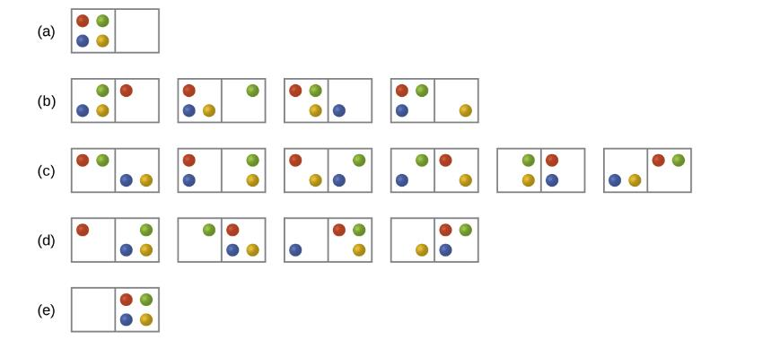
Figure 16.8
The sixteen microstates associated with placing four particles in two boxes are shown. The microstates are collected into five distributions—(a), (b), (c), (d), and (e)—based on the numbers of particles in each box.

Slide 10
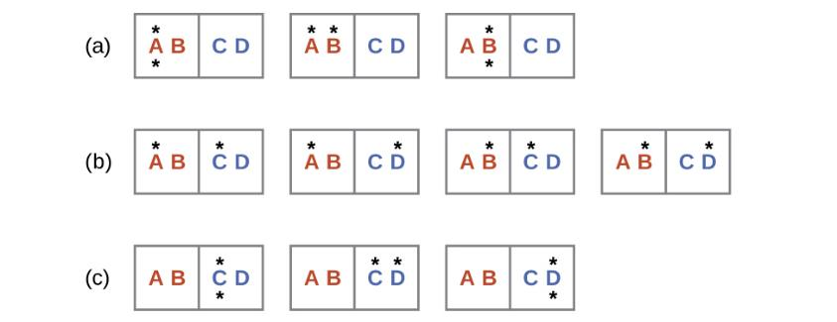
Figure 16.9
This shows a microstate model describing the flow of heat from a hot object to a cold object.
Before the heat flow occurs, the object comprised of particles A and B contains both units of energy and as represented by a distribution of three microstates.
If the heat flow results in an even dispersal of energy (one energy unit transferred), a distribution of four microstates results.
If both energy units are transferred, the resulting distribution has three microstates.

Slide 11
Example 16.2

Slide 12
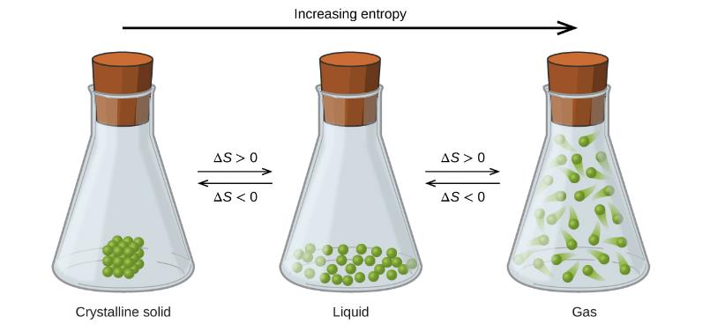
Figure 16.10
The entropy of a substance increases (ΔS > 0) as it transforms from a relatively ordered solid, to a less-ordered liquid, and then to a still less-ordered gas. The entropy decreases (ΔS < 0) as the substance transforms from a gas to a liquid and then to a solid.

Slide 13
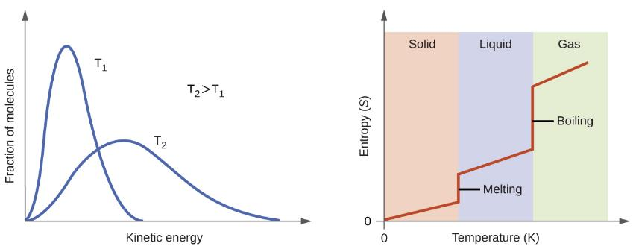
Figure 16.11
Entropy increases as the temperature of a substance is raised, which corresponds to the greater spread of kinetic energies. When a substance melts or vaporizes, it experiences a significant increase in entropy.

Slide 14
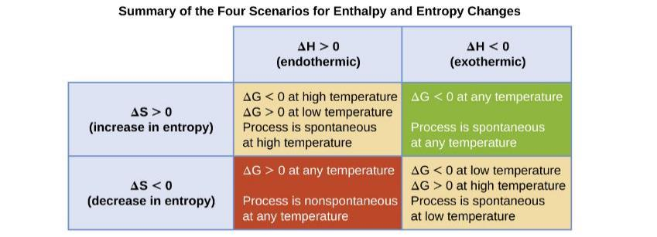
Figure 16.12
There are four possibilities regarding the signs of enthalpy and entropy changes.

Slide 15
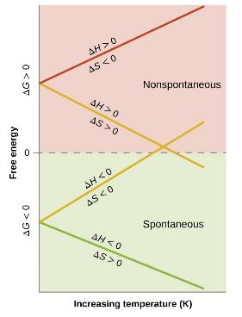
Figure 16.13
These plots show the variation in ΔG with temperature for the four possible combinations of arithmetic sign for ΔH and ΔS.

Slide 16
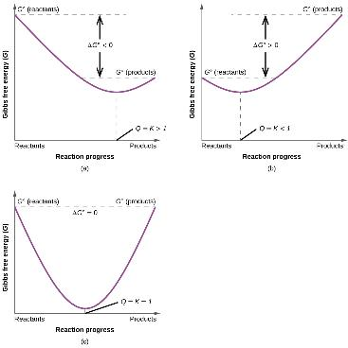
Figure 16.14
These plots show the free energy versus reaction progress for systems whose standard free changes are (a) negative, (b) positive, and (c) zero. Nonequilibrium systems will proceed spontaneously in whatever direction is necessary to minimize free energy and establish equilibrium.

Slide 17
Exercise 55

