Slide 1
CHEMISTRY
Chapter 17 electrochemistry
PowerPoint Image Slideshow

Slide 2
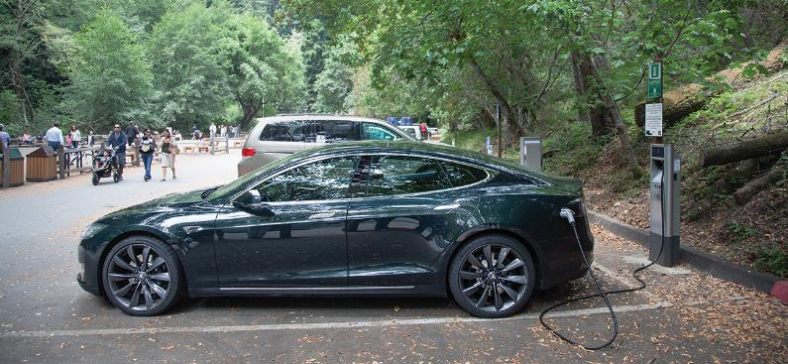
Figure 17.1
Electric vehicles contain batteries that can be recharged, thereby using electric energy to bring about a chemical change and vice versa. (credit: modification of work by Robert Couse-Baker)

Slide 3
Figure 17.2
Electricity-related phenomena include lightning, accumulation of static electricity, and current produced by a battery. (credit left: modification of work by Thomas Bresson; credit middle: modification of work by Chris Darling;credit right: modification of work by Windell Oskay)

Slide 4
Figure 17.3
When a clean piece of copper metal is placed into a clear solution of silver nitrate (a), an oxidation-reduction reaction occurs that results in the exchange of Cu²⁺ for Ag⁺ ions in solution. As the reaction proceeds (b), the solution turns blue (c) because of the copper ions present, and silver metal is deposited on the copper strip as the silver ions are removed from solution. (credit: modification of work by Mark Ott)

Slide 5
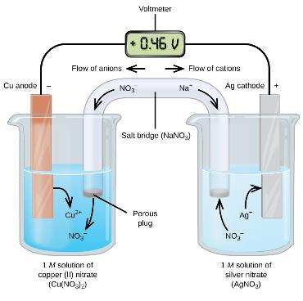
Figure 17.4
In this standard galvanic cell, the half-cells are separated; electrons can flow through an external wire and become available to do electrical work.

Slide 6
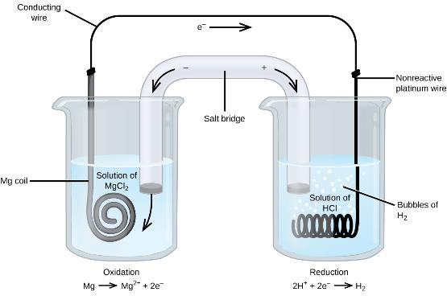
Figure 17.5
The oxidation of magnesium to magnesium ion occurs in the beaker on the left side in this apparatus; the reduction of hydrogen ions to hydrogen occurs in the beaker on the right. A nonreactive, or inert, platinum wire allows electrons from the left beaker to move into the right beaker. The overall reaction is:
Mg + 2H⁺ ⟶ Mg²⁺ + H₂, which is represented in cell notation as:
Mg(s) │ Mg²⁺(aq) ║ H⁺(aq) │ H₂(g) │ Pt(s).

Slide 7
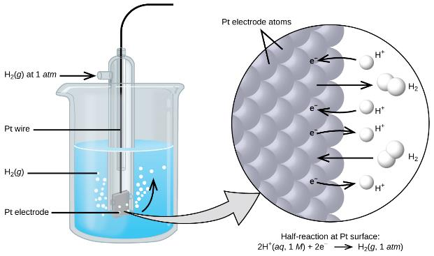
Figure 17.6
Hydrogen gas at 1 atm is bubbled through 1 M HCl solution. Platinum, which is inert to the action of the 1 M HCl, is used as the electrode. Electrons on the surface of the electrode combine with H⁺ in solution to produce hydrogen gas.

Slide 8
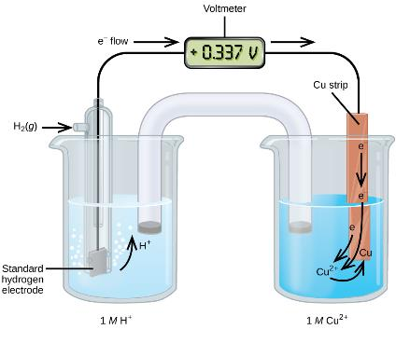
Figure 17.7
A galvanic cell can be used to determine the standard reduction potential of Cu²⁺.

Slide 9
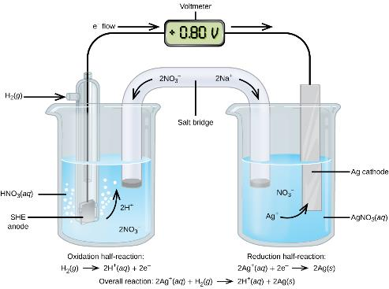
Figure 17.8
A galvanic cell can be used to determine the standard reduction potential of Ag⁺. The SHE on the left is the anode and assigned a standard reduction potential of zero.

Slide 10
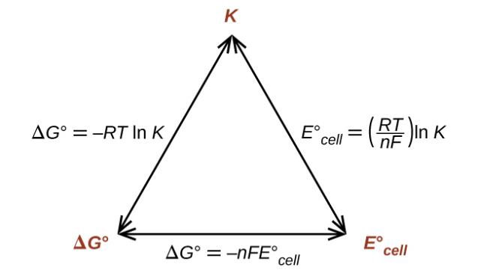
Figure 17.9
The relationships between ΔGº, K, and E°_{cell}. Given any one of the three quantities, the other two can be calculated, so any of the quantities could be used to determine whether a process was spontaneous.

Slide 11
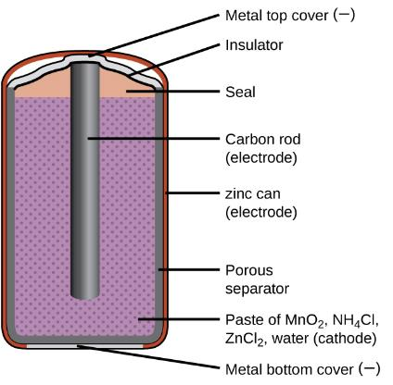
Figure 17.10
The diagram shows a cross section of a flashlight battery, a zinc-carbon dry cell.

Slide 12
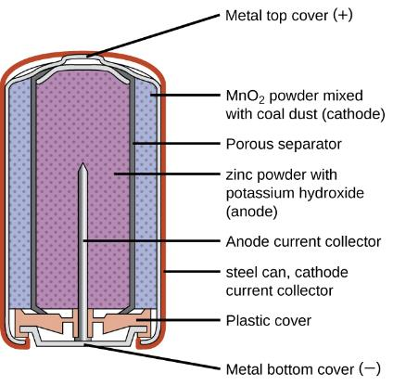
Figure 17.11
Alkaline batteries were designed as direct replacements for zinc-carbon (dry cell) batteries.

Slide 13
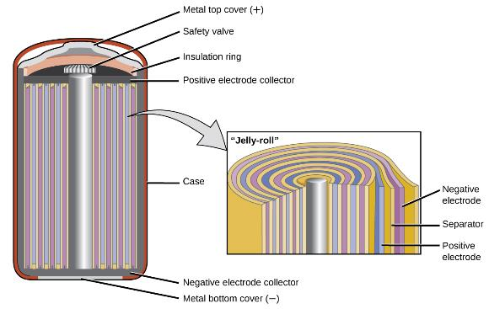
Figure 17.12
NiCd batteries use a “jelly-roll” design that significantly increases the amount of current the battery can deliver as compared to a similar-sized alkaline battery.

Slide 14
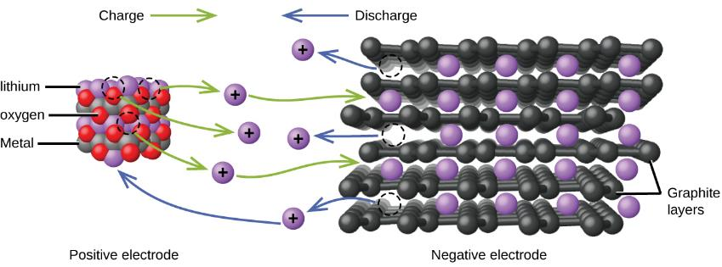
Figure 17.13
In a lithium ion battery, charge flows between the electrodes as the lithium ions move between the anode and cathode.

Slide 15
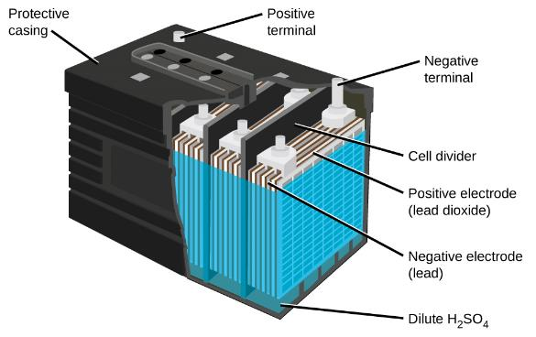
Figure 17.14
The lead acid battery in your automobile consists of six cells connected in series to give 12 V. Their low cost and high current output makes these excellent candidates for providing power for automobile starter motors.

Slide 16
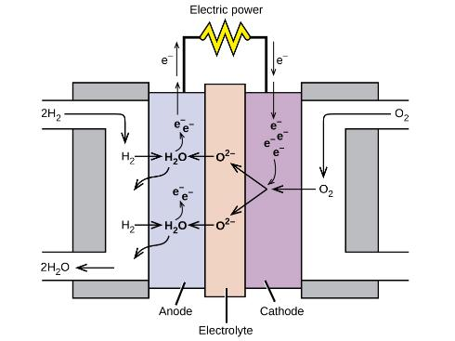
Figure 17.15
In this hydrogen fuel-cell schematic, oxygen from the air reacts with hydrogen, producing water and electricity.

Slide 17
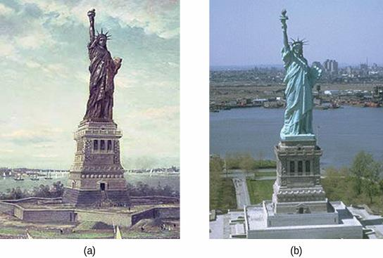
Figure 17.16
The Statue of Liberty is covered with a copper skin, and was originally brown, as shown in this painting.
Exposure to the elements has resulted in the formation of the blue-green patina seen today.

Slide 18
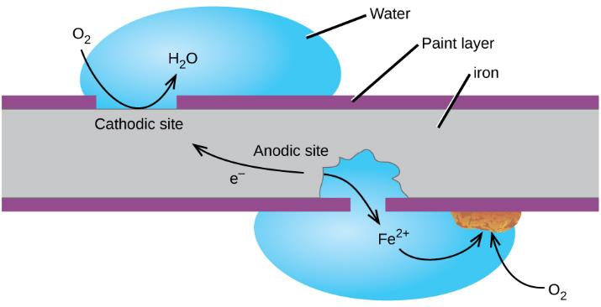
Figure 17.17
Once the paint is scratched on a painted iron surface, corrosion occurs and rust begins to form. The speed of the spontaneous reaction is increased in the presence of electrolytes, such as the sodium chloride used on roads to melt ice and snow or in salt water.

Slide 19
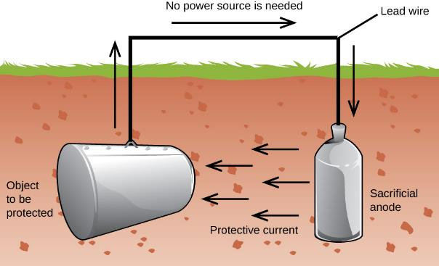
Figure 17.18
One way to protect an underground iron storage tank is through cathodic protection. Using an active metal like zinc or magnesium for the anode effectively makes the storage tank the cathode, preventing it from corroding (oxidizing).

Slide 20
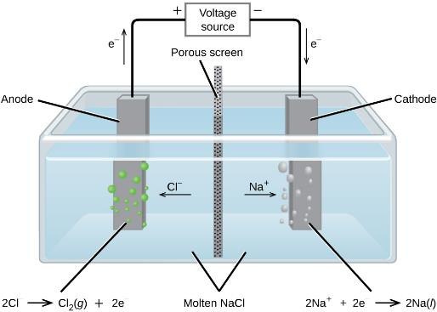
Figure 17.19
Passing an electric current through molten sodium chloride decomposes the material into sodium metal and chlorine gas. Care must be taken to keep the products separated to prevent the spontaneous formation of sodium chloride.

Slide 21
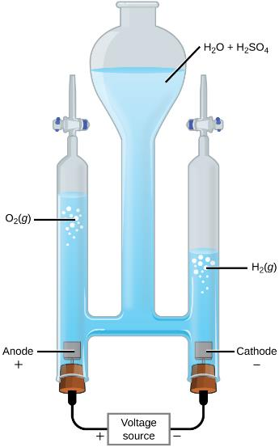
Figure 17.20
Water decomposes into oxygen and hydrogen gas during electrolysis. Sulfuric acid was added to increase the concentration of hydrogen ions and the total number of ions in solution, but does not take part in the reaction. The volume of hydrogen gas collected is twice the volume of oxygen gas collected, due to the stoichiometry of the reaction.

Slide 22
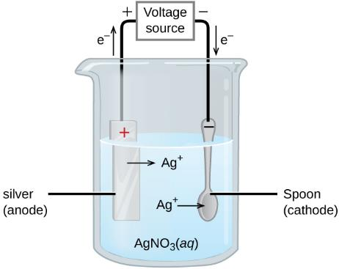
Figure 17.21
The spoon, which is made of an inexpensive metal, is connected to the negative terminal of the voltage source and acts as the cathode. The anode is a silver electrode. Both electrodes are immersed in a silver nitrate solution. When a steady current is passed through the solution, the net result is that silver metal is removed from the anode and deposited on the cathode.

